Slide 1
CS 230 – Systems Programming
WK6-Day1: Functions in C

Slide 2
AGENDA
Prayer
Project 2 – Q & A
Project 3–Due–Monday-10/8/18
Quiz–Selection/Loops-Wednesday, 10/3/18
Review-Loops in C
Functions in C
Q & A

Slide 3
My intimate nearness
NEVER TAKE FOR GRANTED My intimate nearness. Marvel at the wonder of My continual Presence with you. Even the most ardent human lover cannot be with you always. Nor can another person know the intimacies of your heart, mind, and spirit. I know everything about you— even to the number of hairs on your head. You don’t need to work at revealing yourself to Me.

Slide 4
My intimate nearness
Many people spend a lifetime or a small fortune searching for someone who understands them. Yet I am freely available to all who call upon My Name, who open their hearts to receive Me as Savior. This simple act of faith is the beginning of a lifelong love story. I, the Lover of your soul, understand
you perfectly and love you eternally.
LUKE 12 : 7; JOHN 1 : 12; ROMANS 10 : 13; Reference: Jesus Calling-Sarah Young

Slide 5
Prayer
Prayer Request
Mrs. Grissom
Let us Pray for families affected by
Earthquake and Tsunami - Indonesia

Slide 6
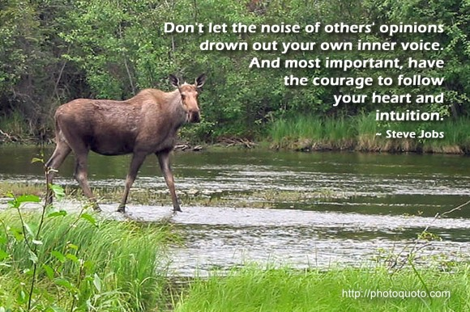

Wisdom

Slide 7
Humor
A guy is standing on the corner of the street smoking one cigarette after another. A lady walking by notices him and says "Hey, don't you know that those things can kill you? I mean, didn't you see the giant warning on the box?!" "That's OK" says the guy, puffing casually "I'm a computer programmer" "So? What's that got to do with anything?" "We don't care about warnings. We only care about errors."

Slide 8
AGENDA
Prayer
Project 2 – Q & A
Project 3–Due–Monday-10/8/18
Quiz–Selection/Loops-Wednesday, 10/3/18
Review-Loops in C
Functions in C
Q & A

Slide 9
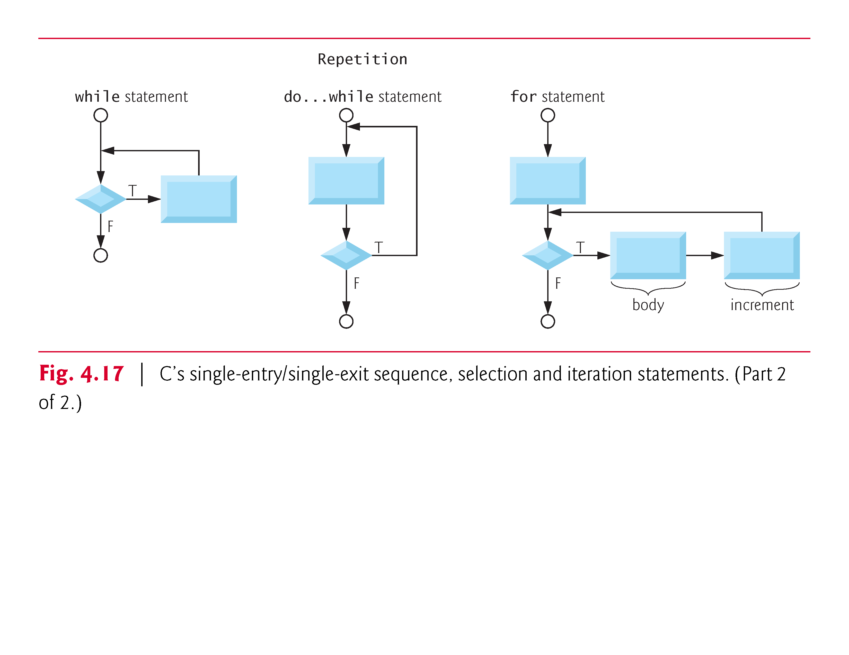

Slide 10
Today
Demo - Loops in C

Slide 11
Examples Using the for Statement
Application: Compound-Interest Calculations
Consider the following problem statement:
A person invests $1000.00 in a savings account yielding 5% interest. Assuming that all interest is left on deposit in the account, calculate and print the amount of money in the account at the end of each year for 10 years. Use the following formula for determining these amounts:
a = p(1 + r)^{n}
where
p is the original amount invested (i.e., the principal) r is the annual interest rate n is the number of years a is the amount on deposit at the end of the n^{th} year.
This problem involves a loop that performs the indicated calculation for each of the 10 years the money remains on deposit.
The solution is shown in Fig. 4.6.
-gcc –o filename filename.c –lm (lm – for math libarary)

Slide 12
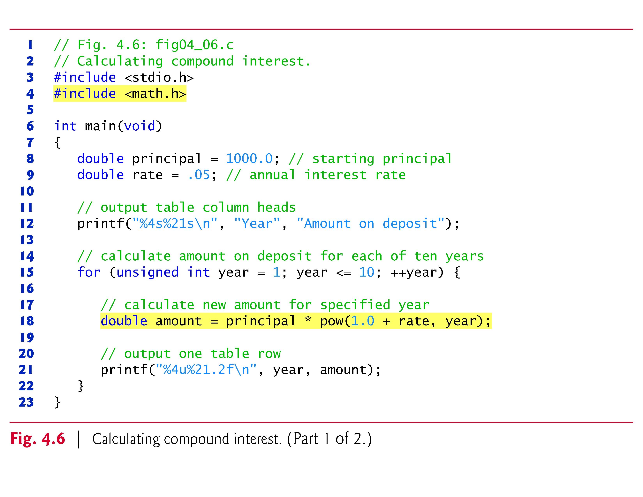

Slide 13
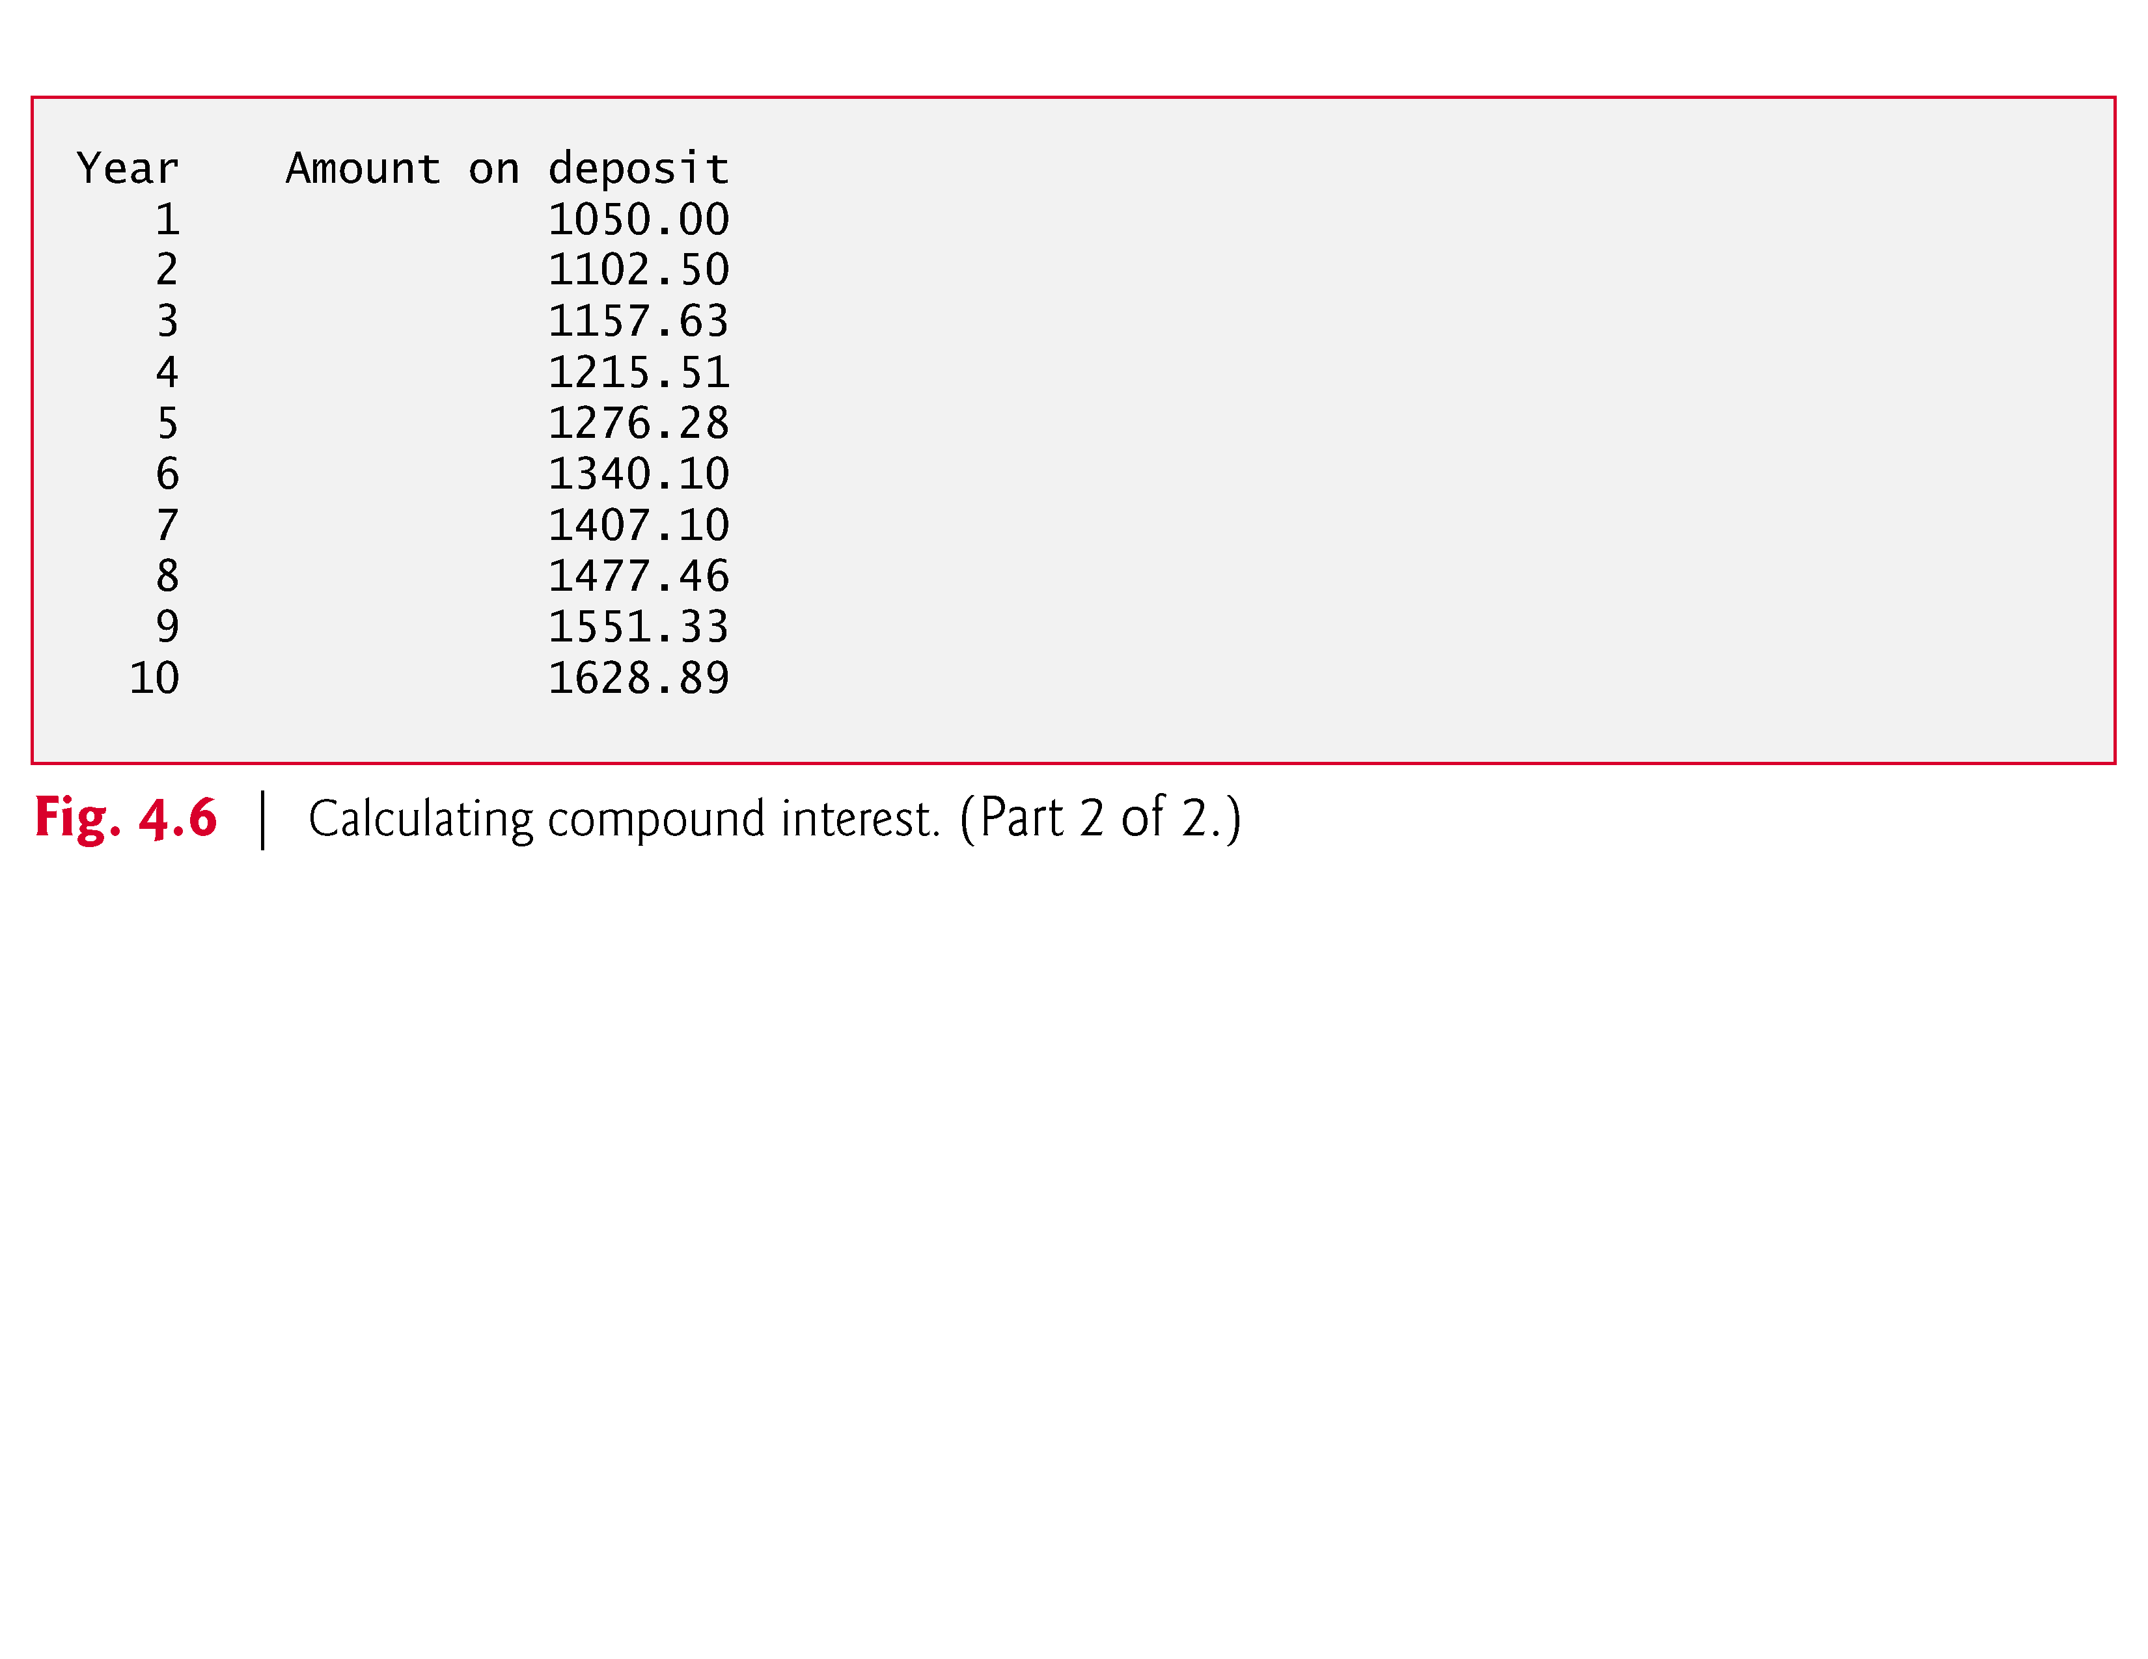

Slide 14
AGENDA
Prayer
Project 2 – Q & A
Project 3–Due–Monday-10/8/18
Quiz–Selection/Loops-Wednesday, 10/3/18
Review-Loops in C
Functions in C
Q & A

Slide 15
Introduction
Most computer programs that solve real-world problems are much larger than the programs presented in the first few weeks.
Experience has shown that the best way to develop and maintain a large program is to construct it from smaller pieces, each of which is more manageable than the original program.
This technique is called divide and conquer.
This lesson we learn some key features of the C language that facilitate the design, implementation, operation and maintenance of large programs.

Slide 16
Modularizing Programs in C
Functions are used to modularize programs
C programs are typically written by combining new functions you write with prepackaged functions available in the C standard library.
The C standard library provides a rich collection of functions for performing common mathematical calculations, string manipulations, character manipulations, input/output, and many other useful operations.

Slide 17
Modularizing Programs in C (Cont.)
The functions printf, scanf and pow that we’ve used in previous lessons are standard library functions.
You can write your own functions to define tasks that may be used at many points in a program.
These are sometimes referred to as programmer-defined functions.
The statements defining the function are written only once, and the statements are hidden from other functions.
Functions are invoked by a function call, which specifies the function name and provides information (as arguments) that the called function needs to perform its designated task.

Slide 18
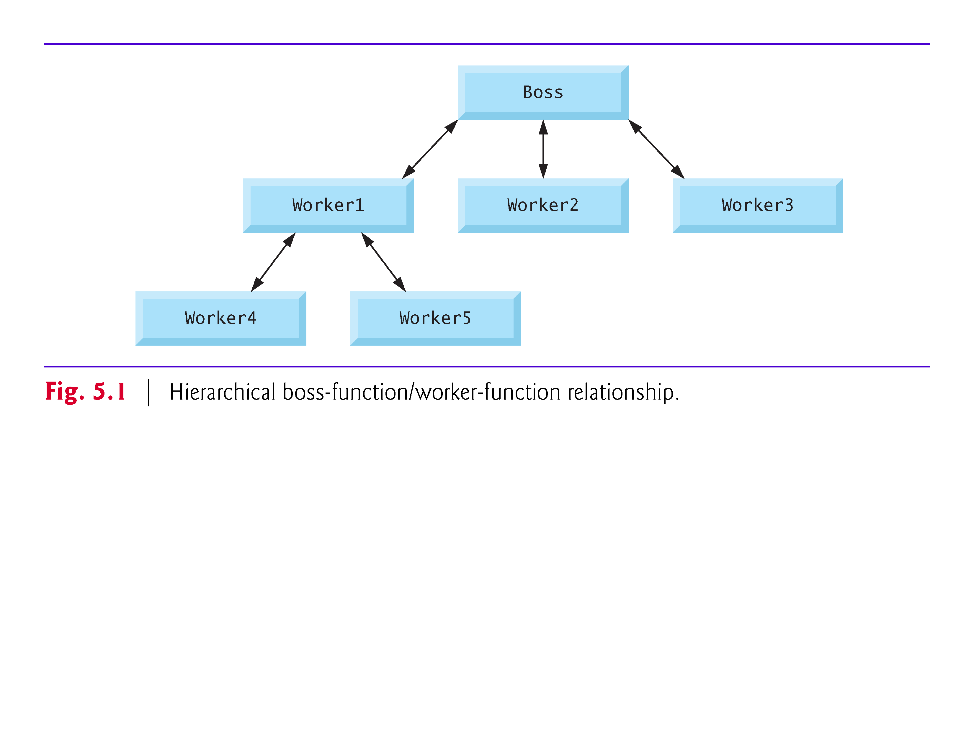

Slide 19
Modularizing Programs in C (Cont.)
The worker may call other worker functions, and the boss will be unaware of this.
We’ll soon see how this “hiding” of implementation details promotes good software engineering.
Figure 5.1 shows a boss function communicating with several worker functions in a hierarchical manner.
Note that worker1 acts as a boss function to worker4 and worker5.
Relationships among functions may differ from the hierarchical structure shown in this figure.

Slide 20
Math Library Functions
Math library functions allow you to perform certain common mathematical calculations.
Functions are normally used in a program by writing the name of the function followed by a left parenthesis followed by the argument (or a comma-separated list of arguments) of the function followed by a right parenthesis.
For example, a programmer desiring to calculate and print the square root of 900.0 you might write
printf("%.2f", sqrt(900.0));
When this statement executes, the math library function sqrt is called to calculate the square root of the number contained in the parentheses (900.0).

Slide 21
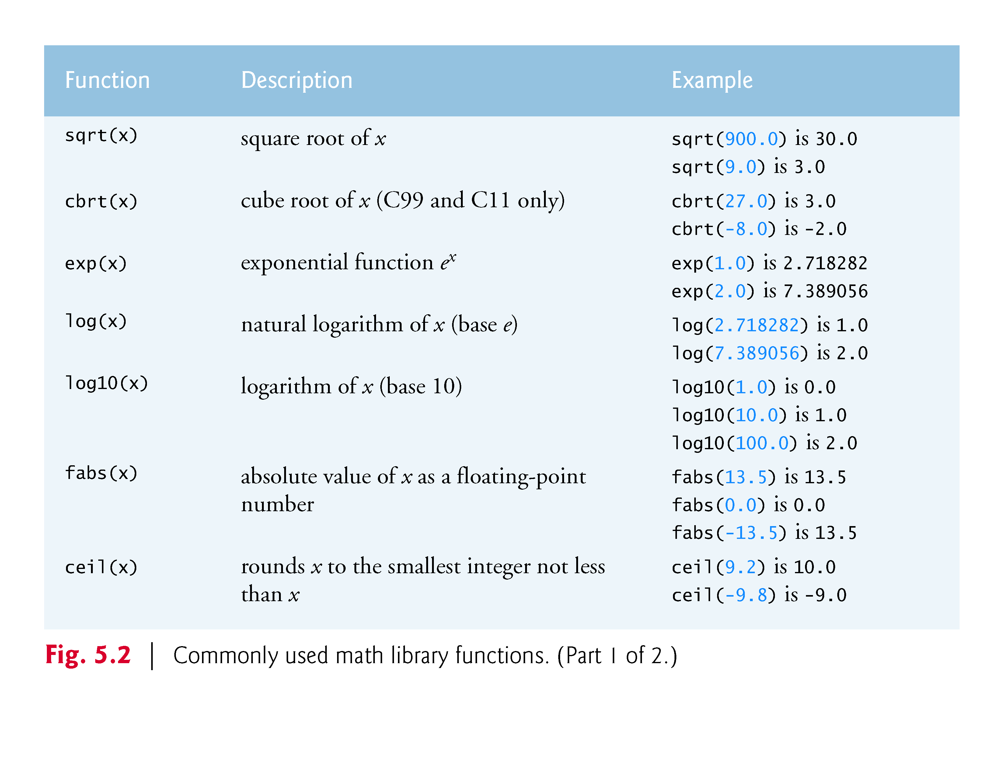

Slide 22
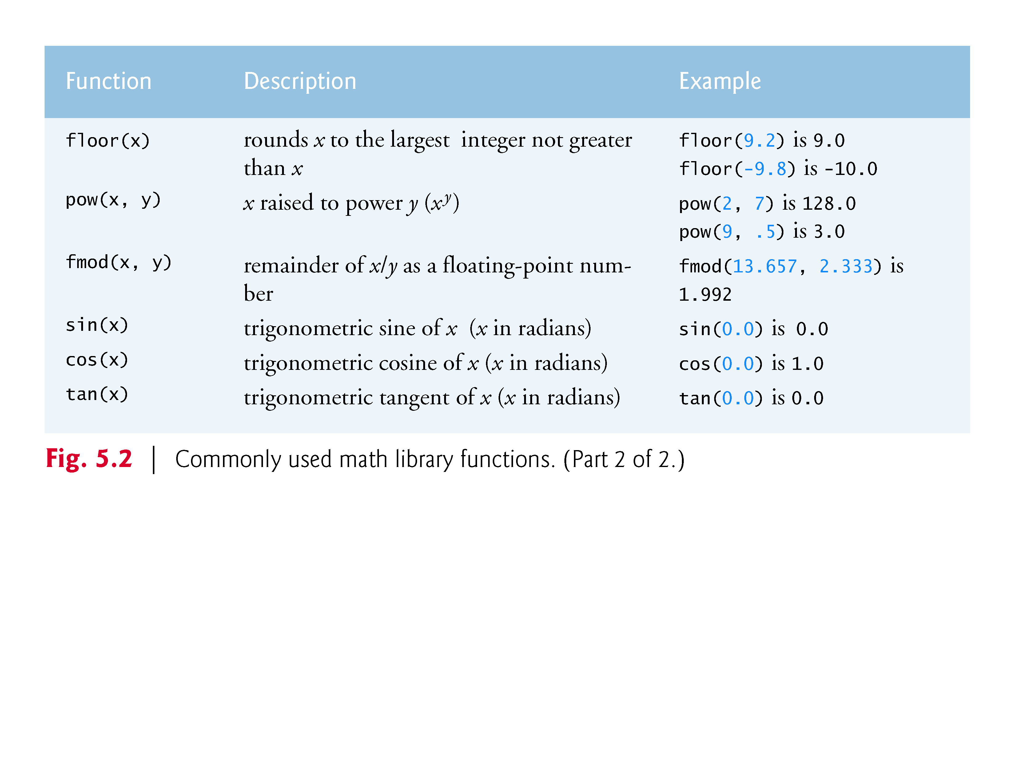

Slide 23
Functions
Functions allow you to modularize a program.
All variables defined in function definitions are local variables—they can be accessed only in the function in which they’re defined.
Most functions have a list of parameters that provide the means for communicating information between functions.
A function’s parameters are also local variables of that function.

Slide 24
Functions (Cont.)
There are several motivations for “functionalizing” a program.
The divide-and-conquer approach makes program development more manageable.
Another motivation is software reusability—using existing functions as building blocks to create new programs.
We use abstraction each time we use standard library functions like printf, scanf and pow.
A third motivation is to avoid repeating code in a program.
Packaging code as a function allows the code to be executed from other locations in a program simply by calling the function.

Slide 25
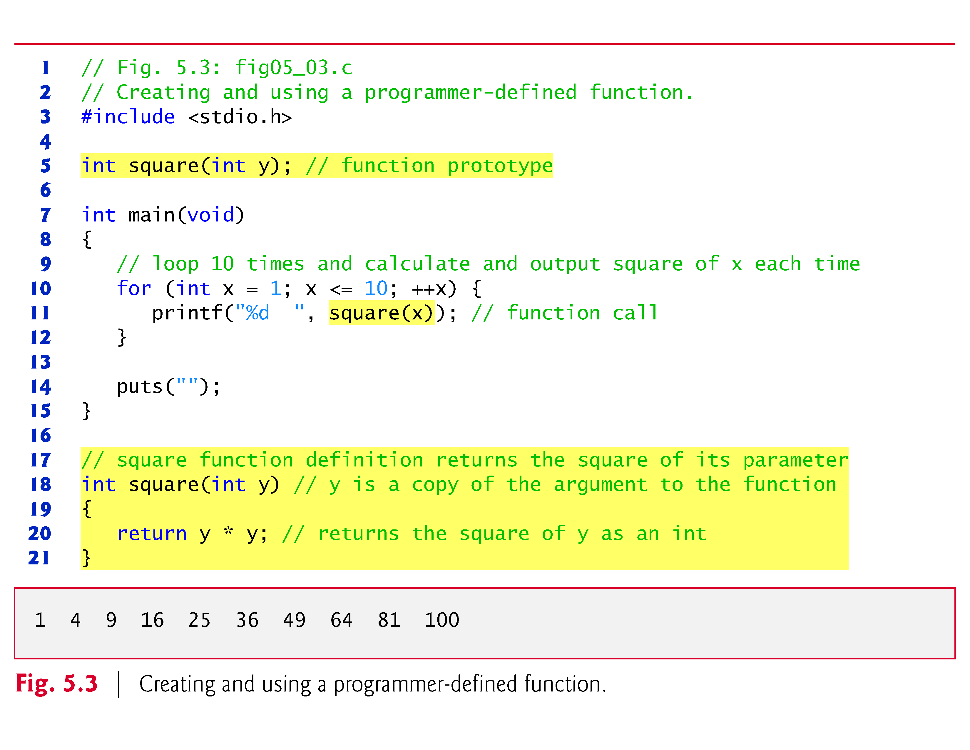

Slide 26
Function Definitions (Cont.)
The format of a function definition is
return-value-type function-name(parameter-list) { definitions statements }

Slide 27
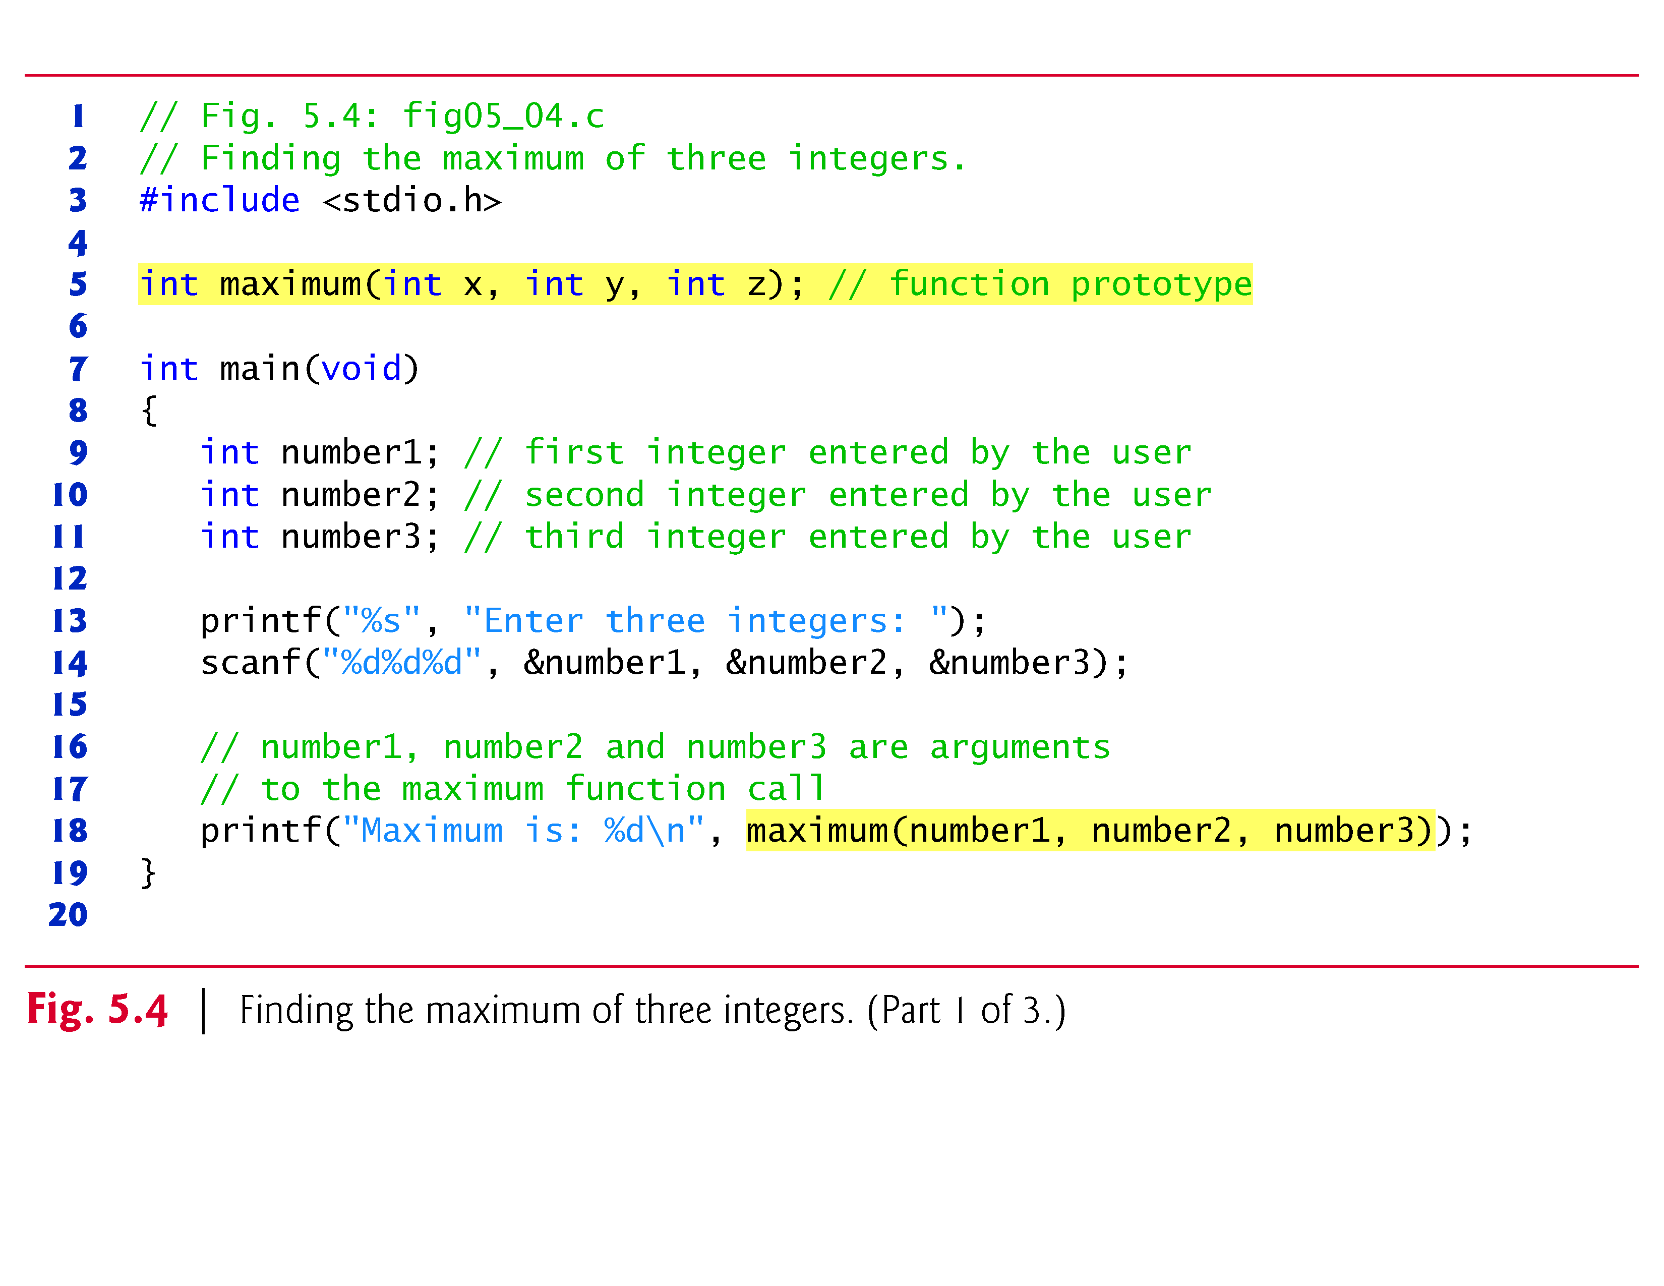

Slide 28
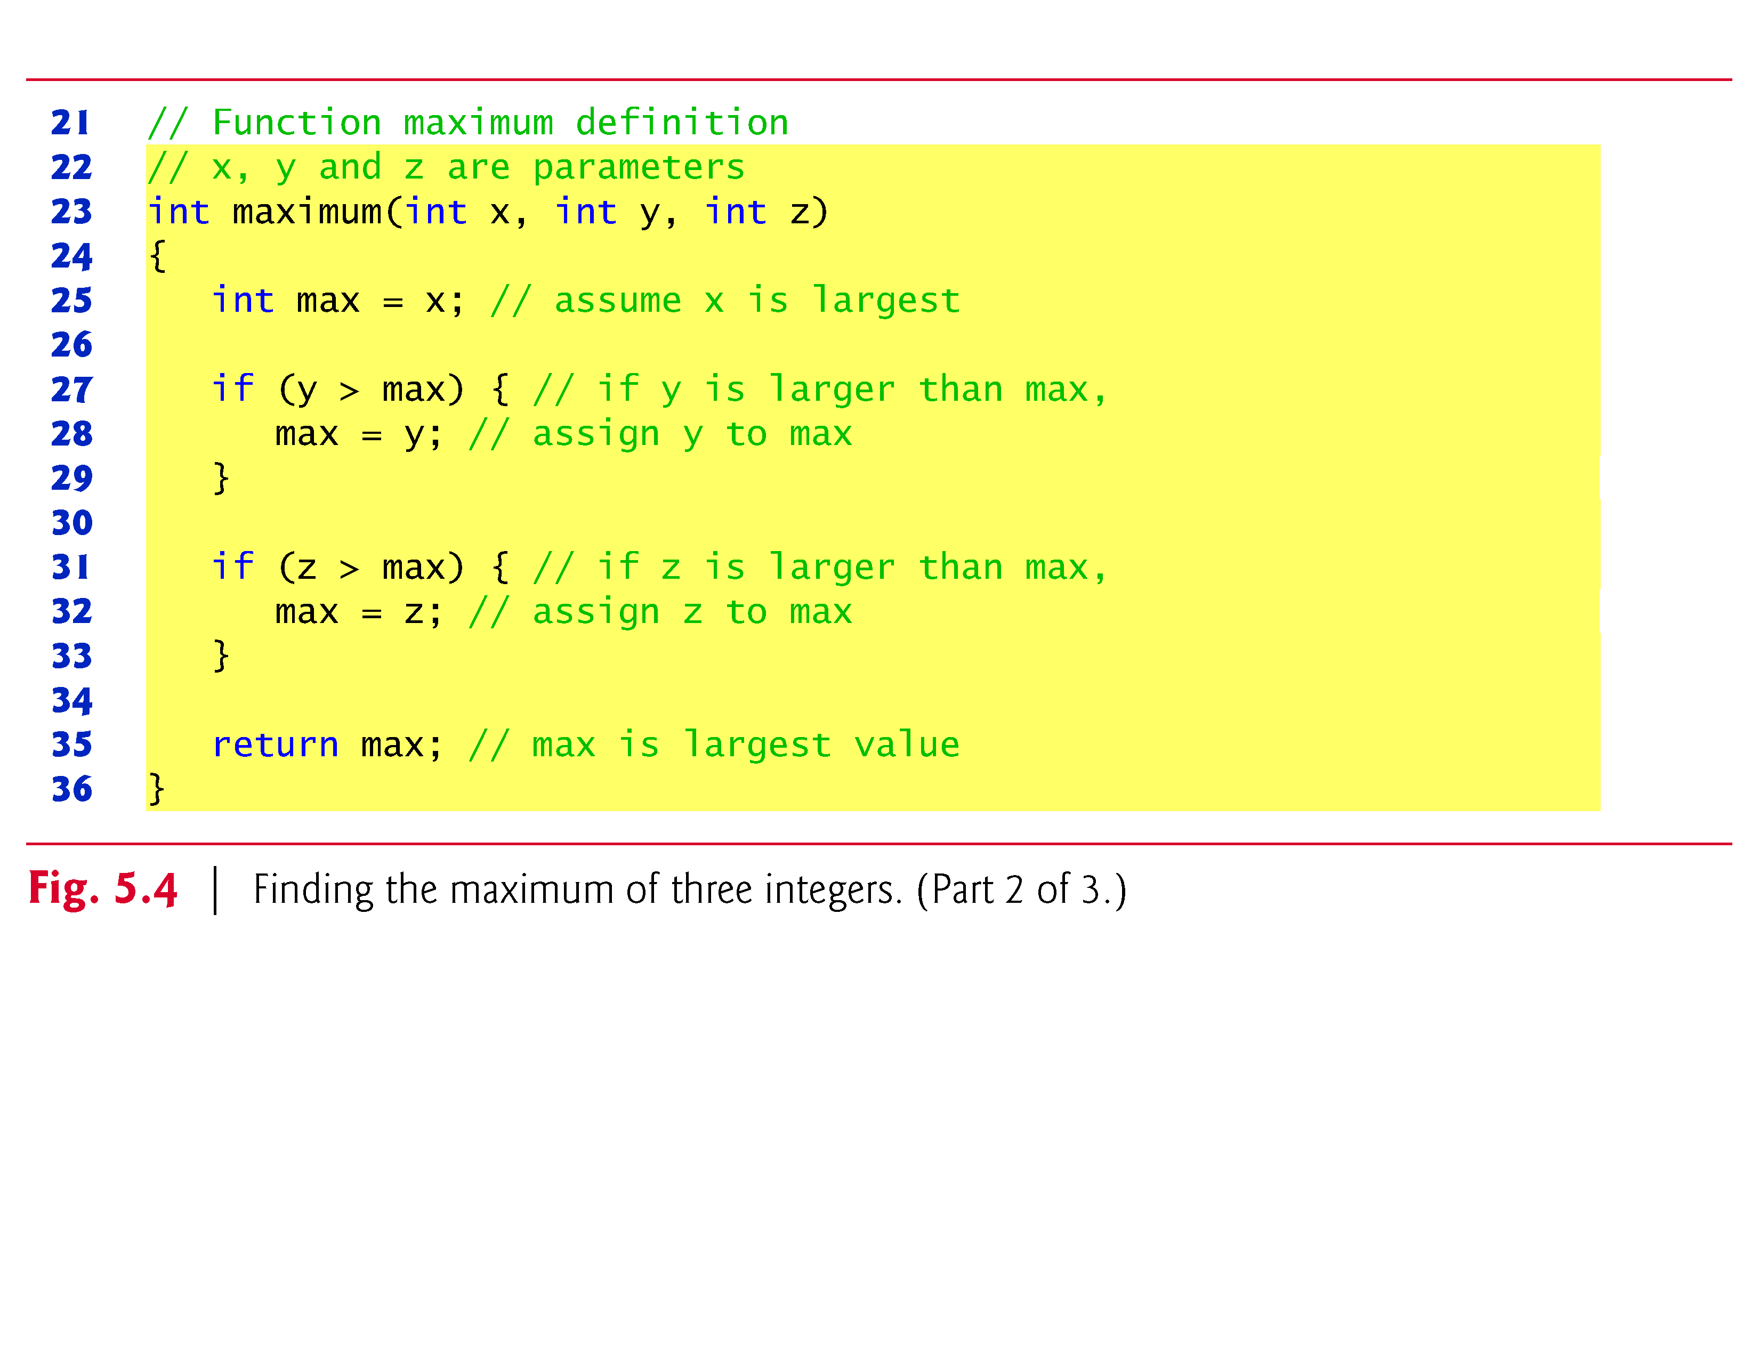

Slide 29
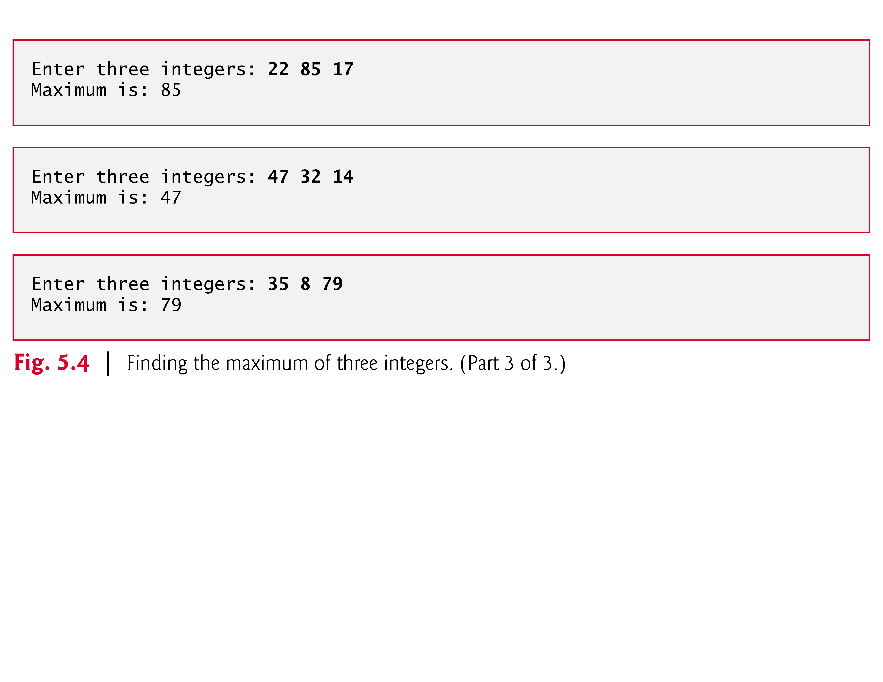

Slide 30
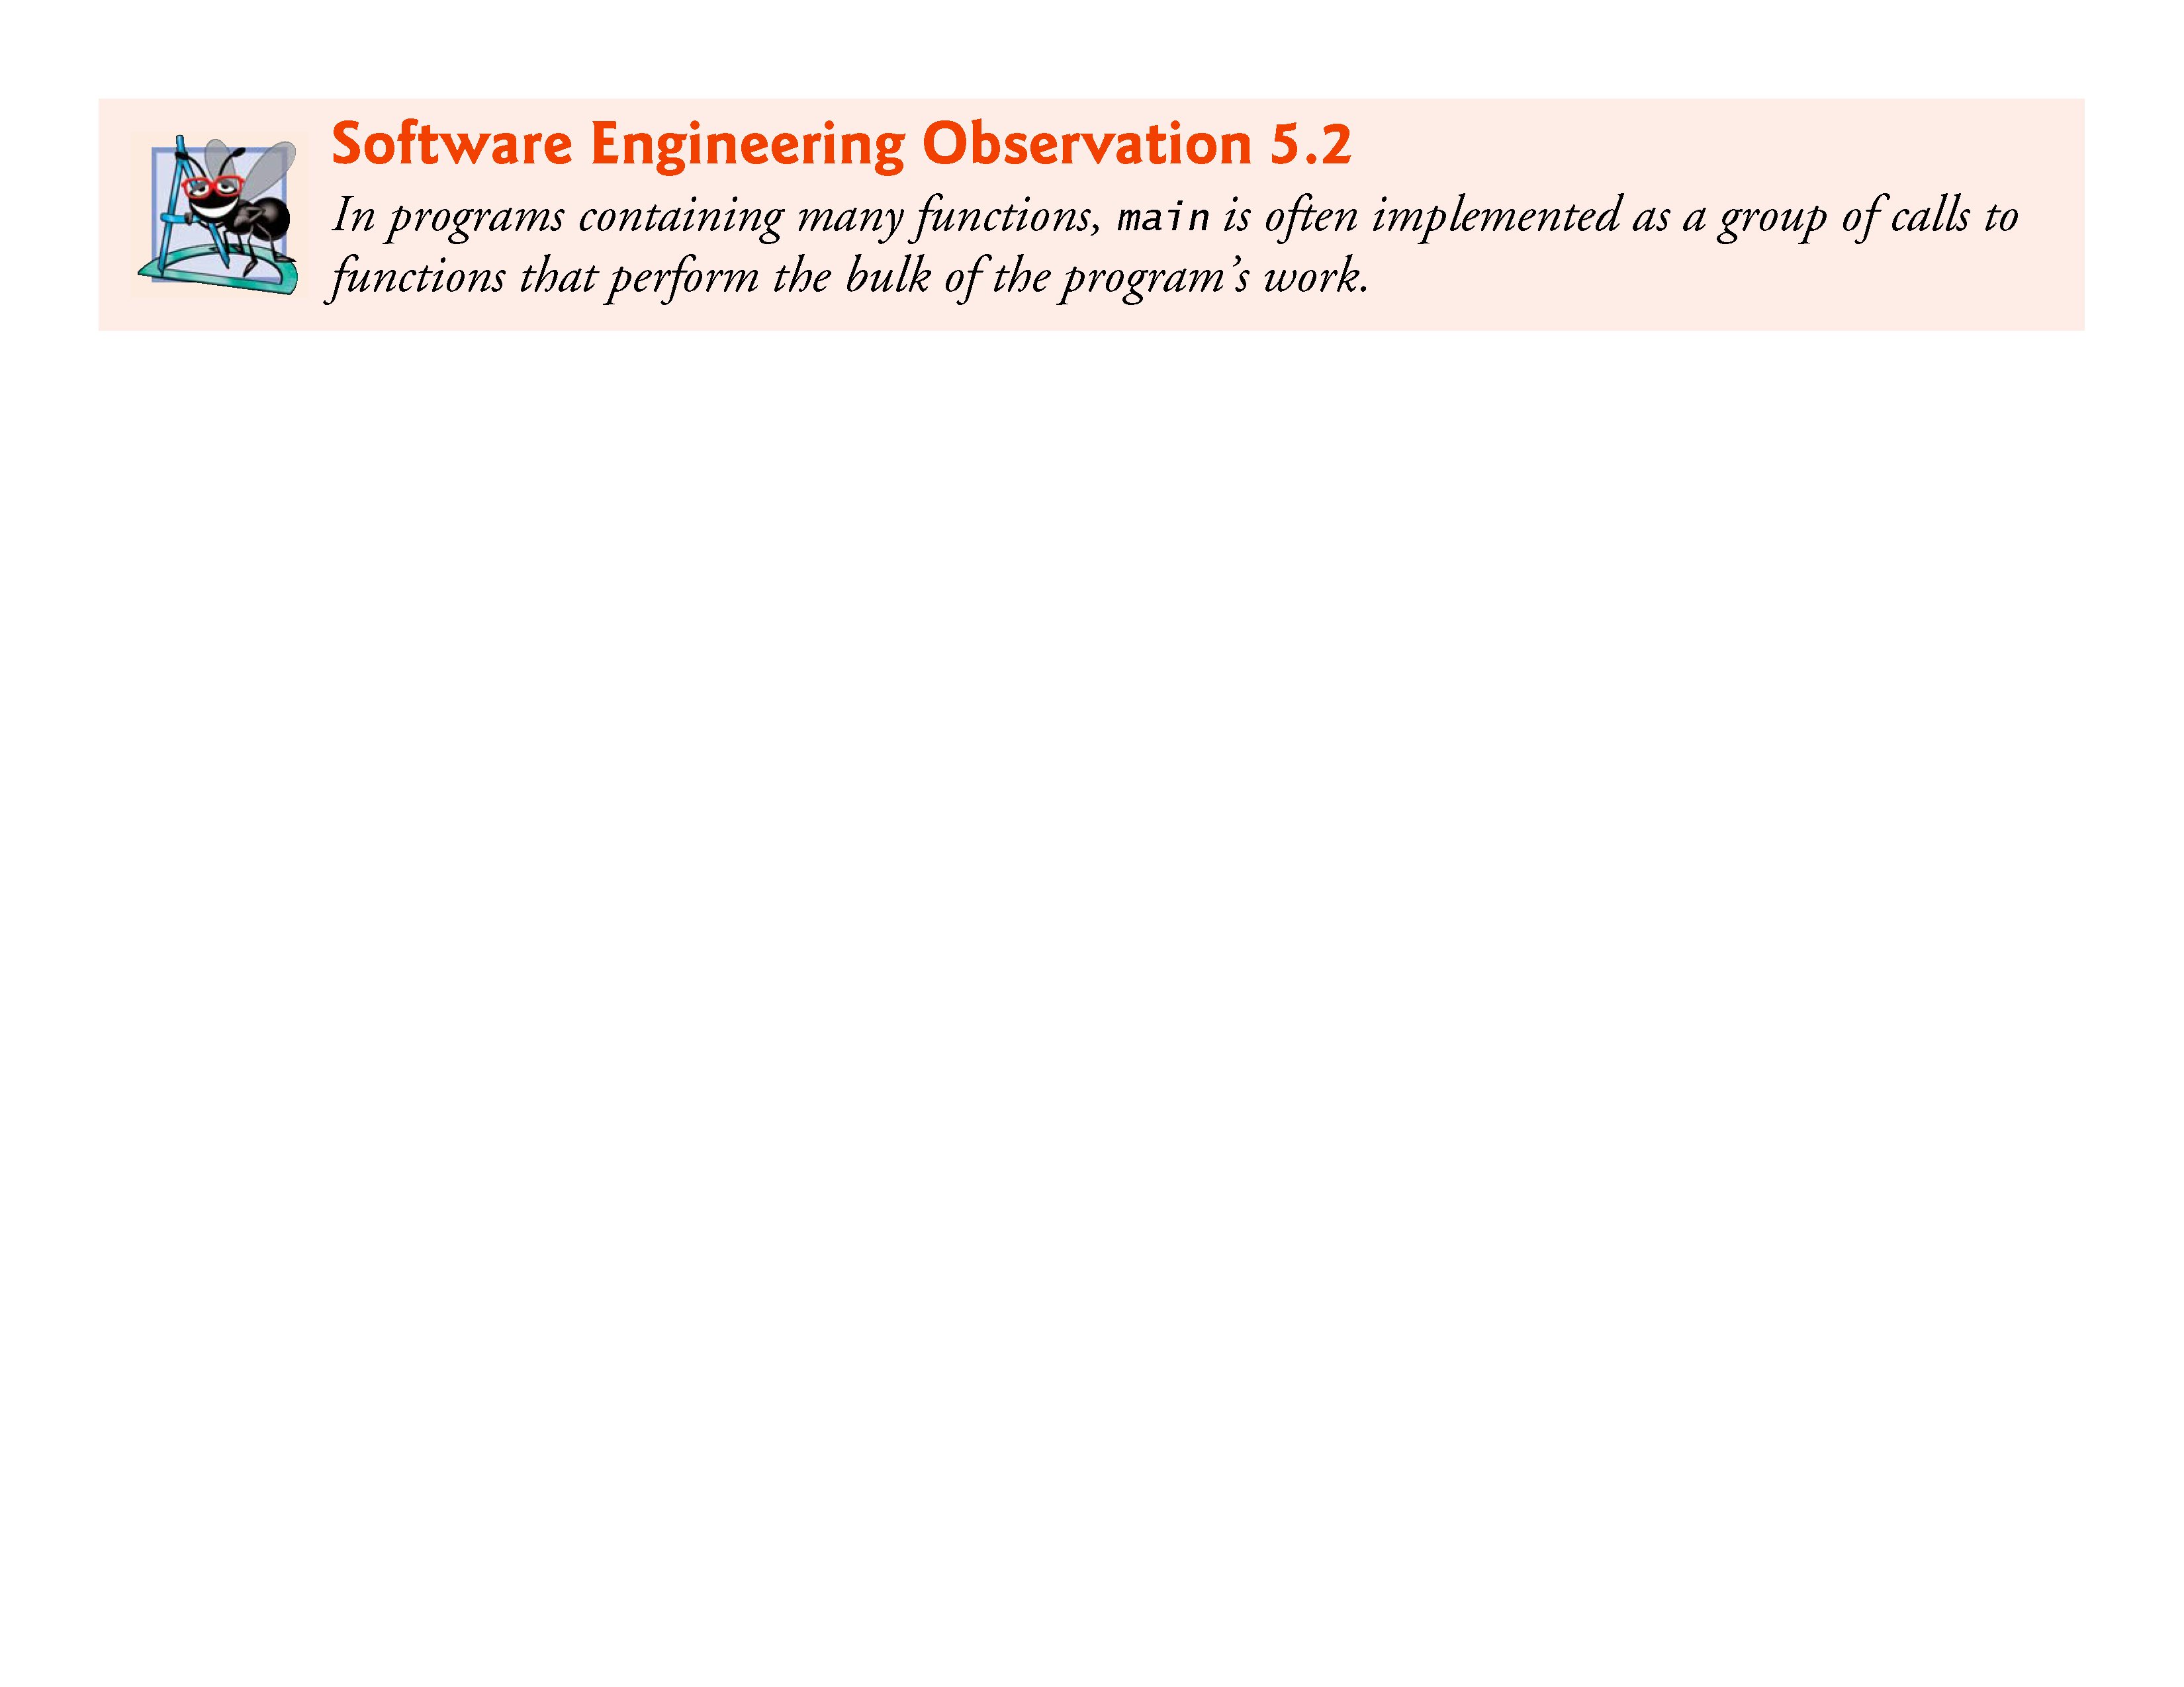

Slide 31
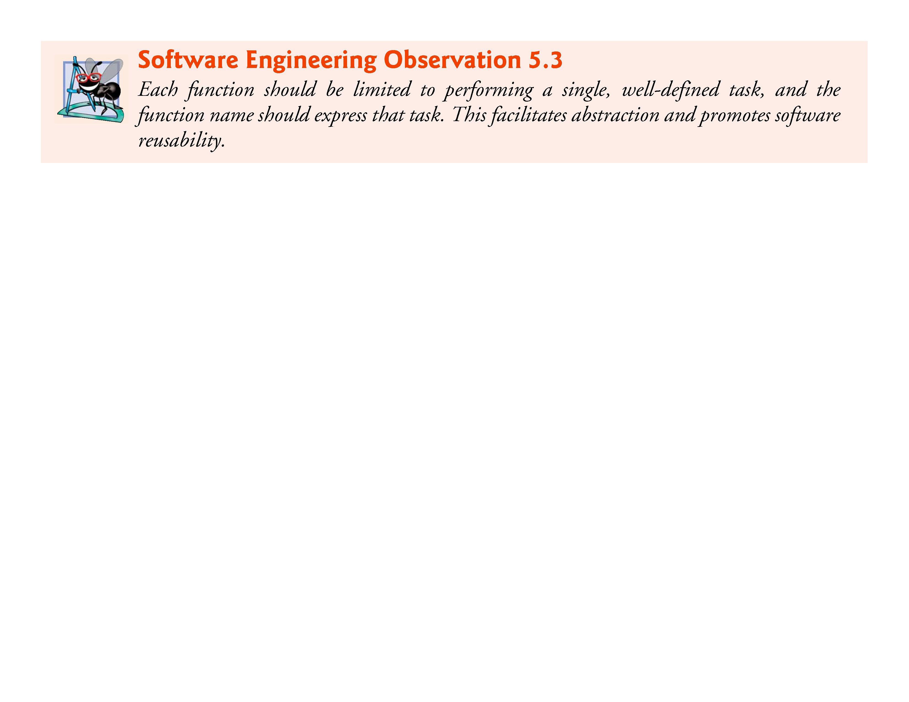

Slide 32
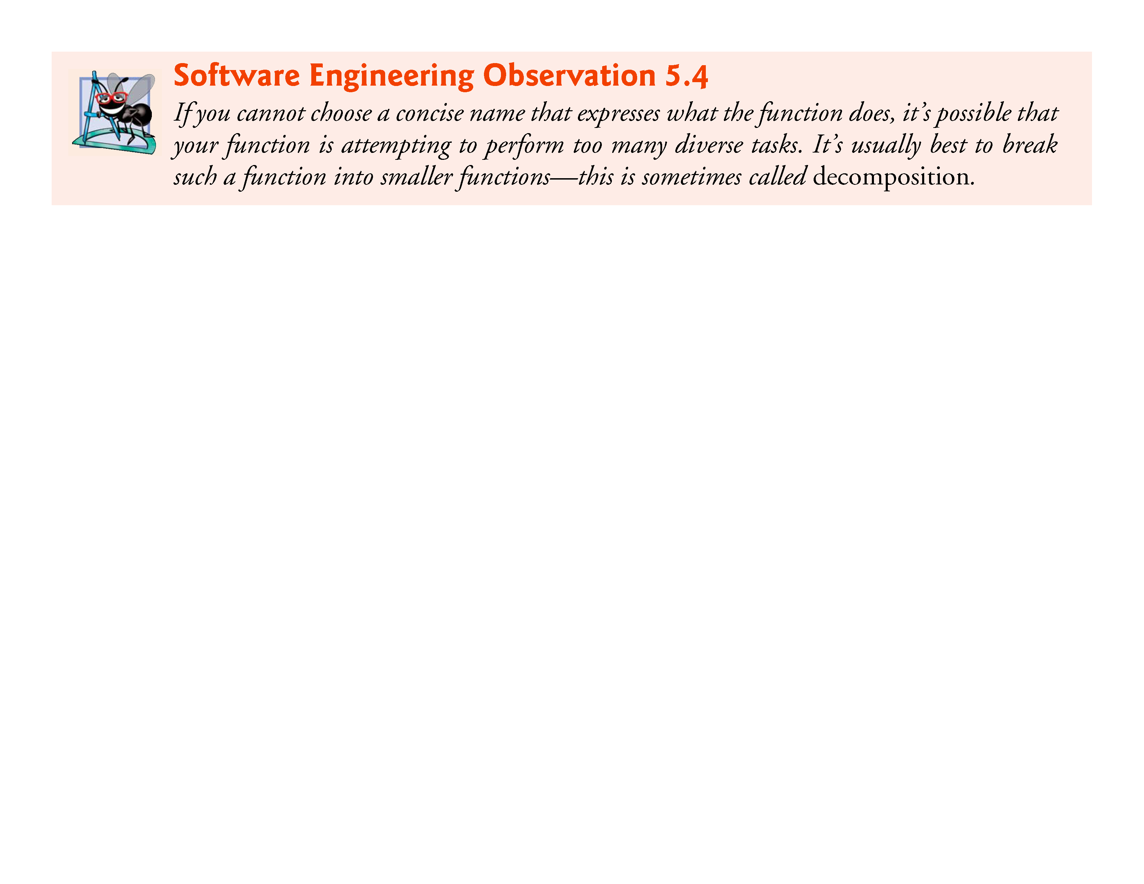

Slide 33
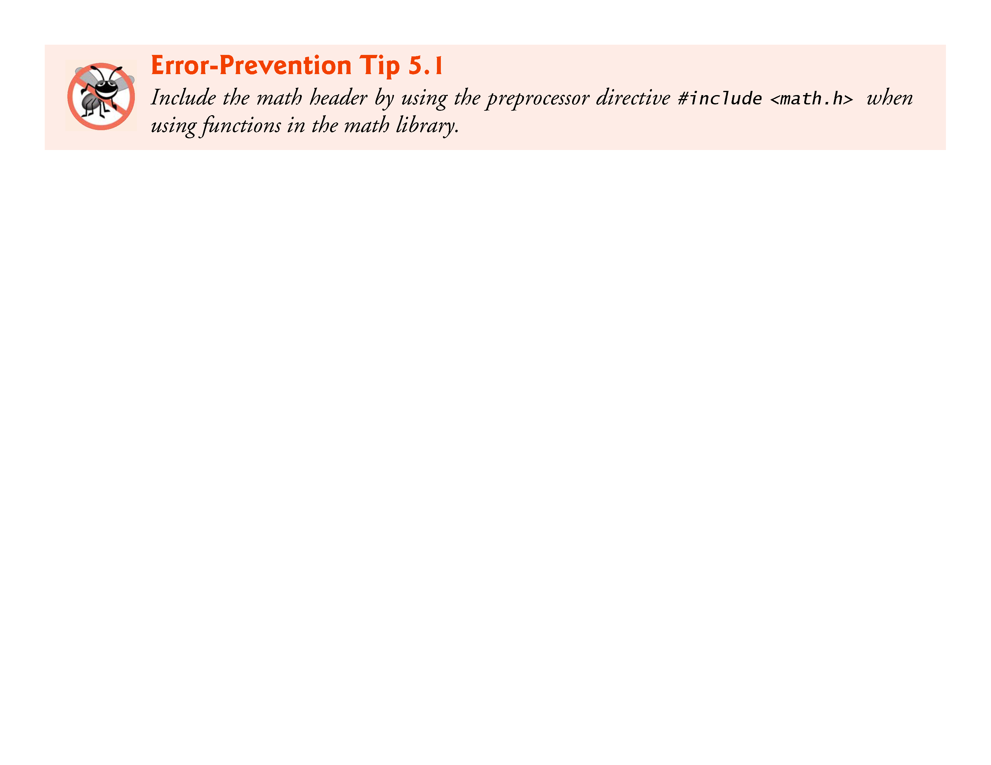

Slide 34
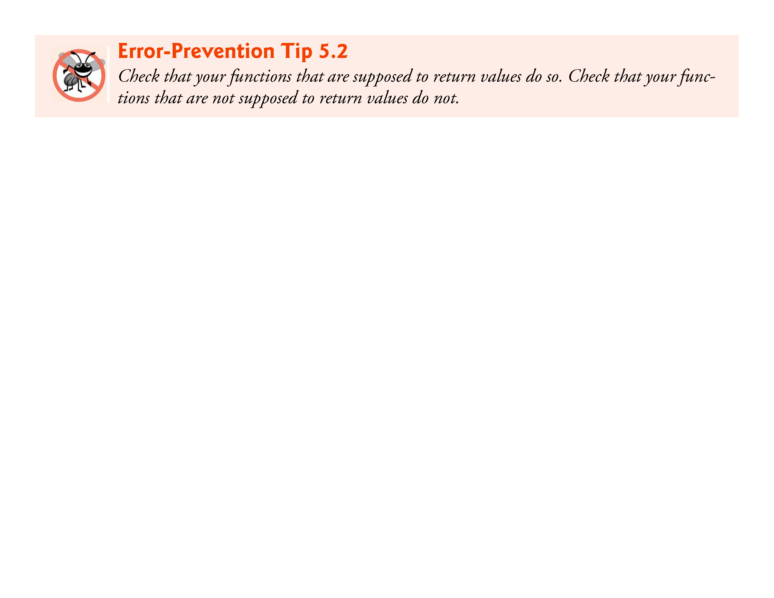

Slide 35
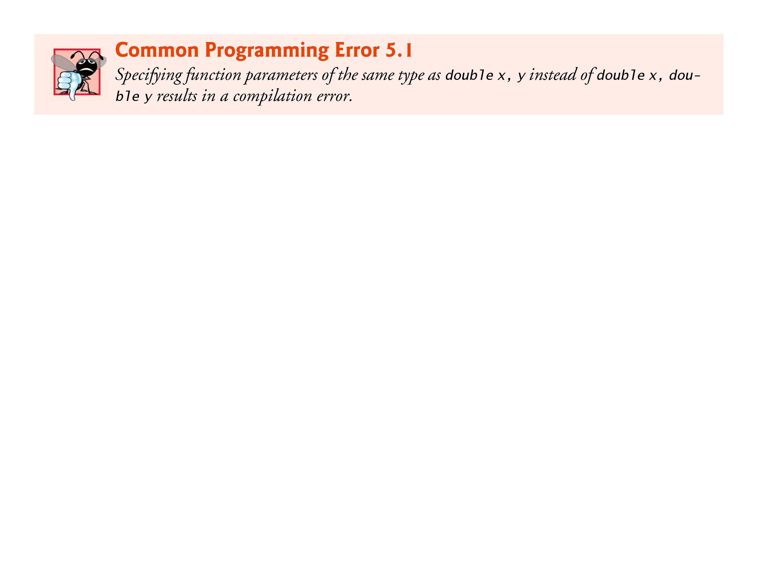

Slide 36
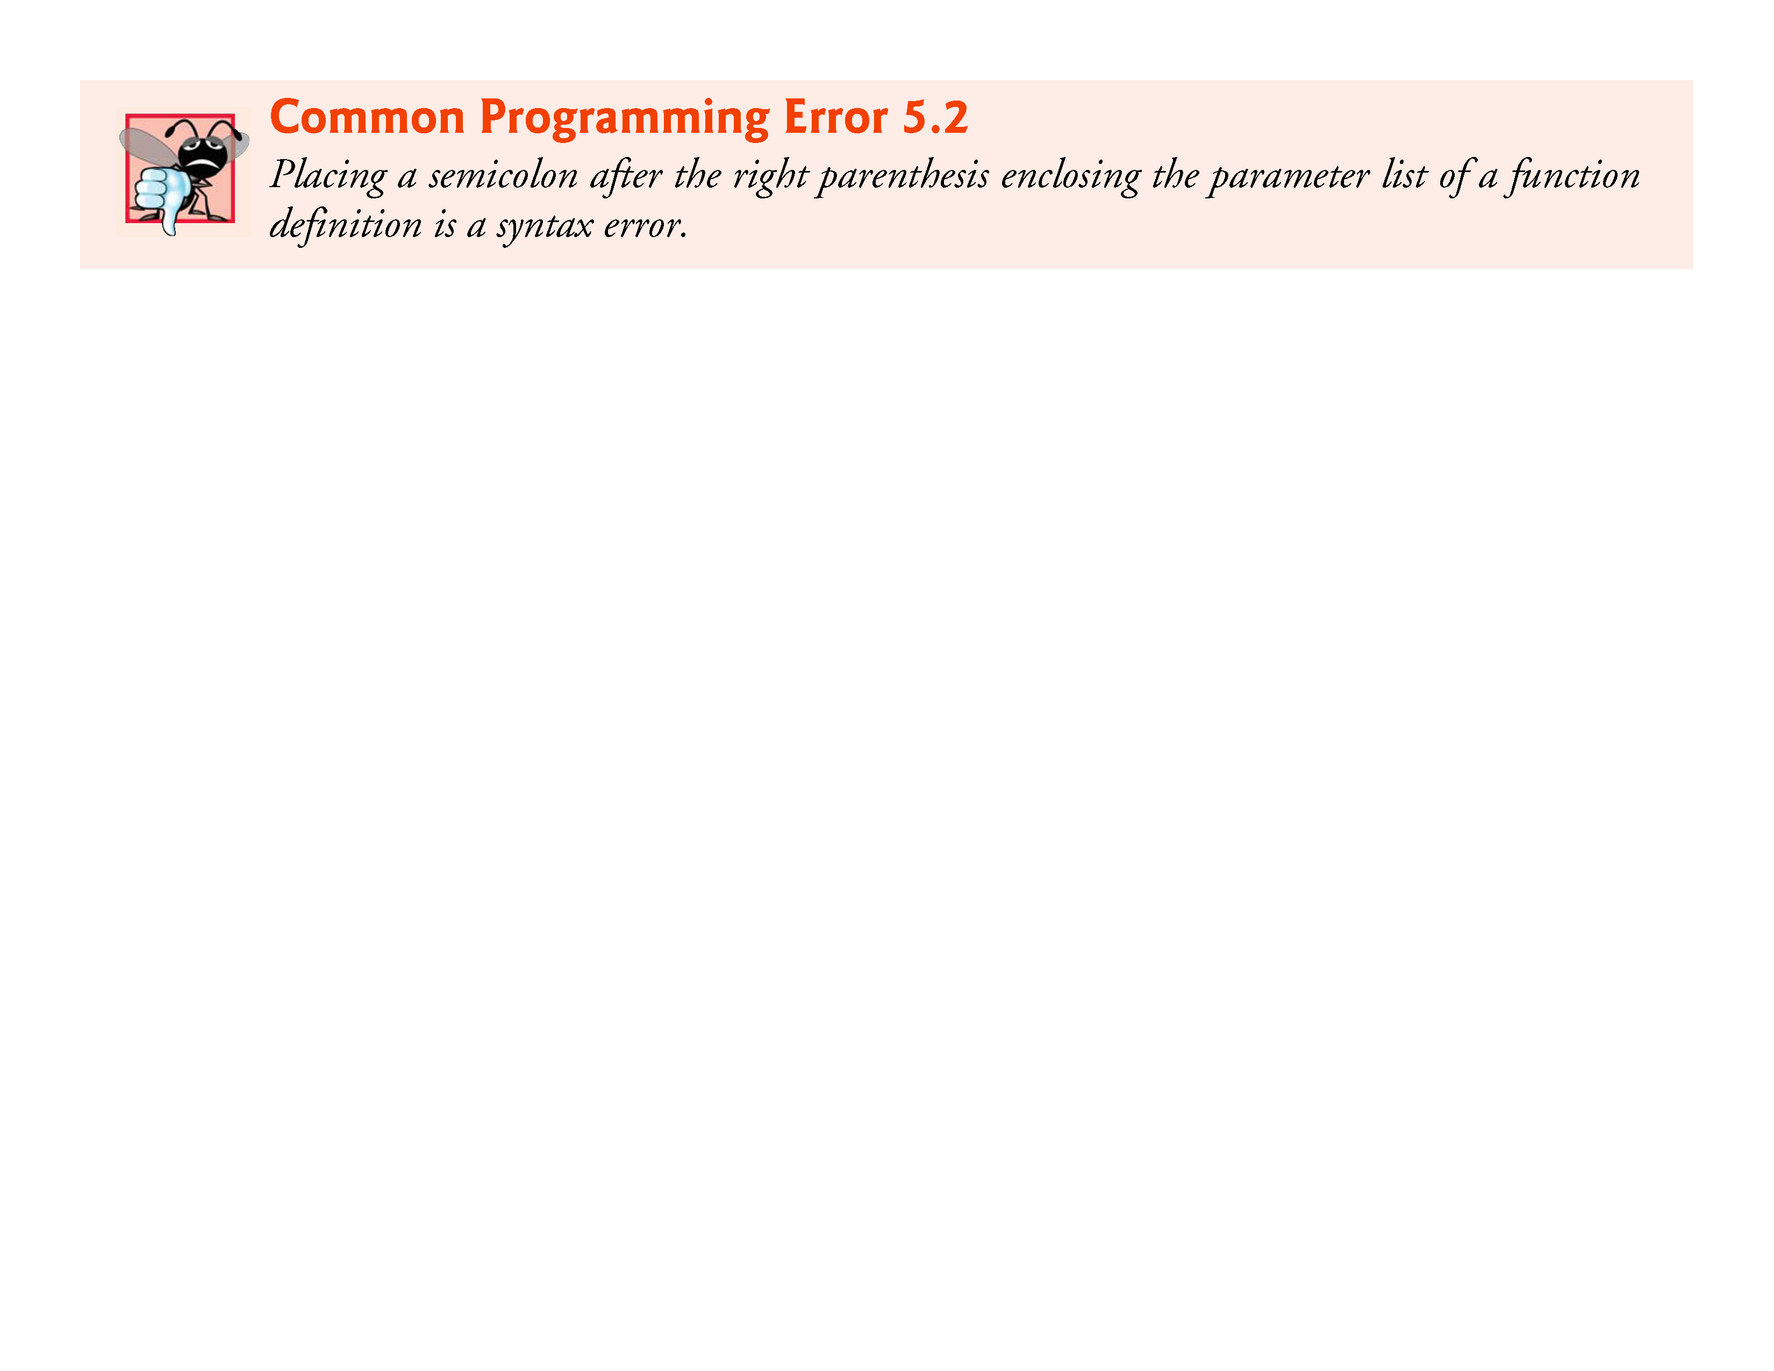

Slide 37
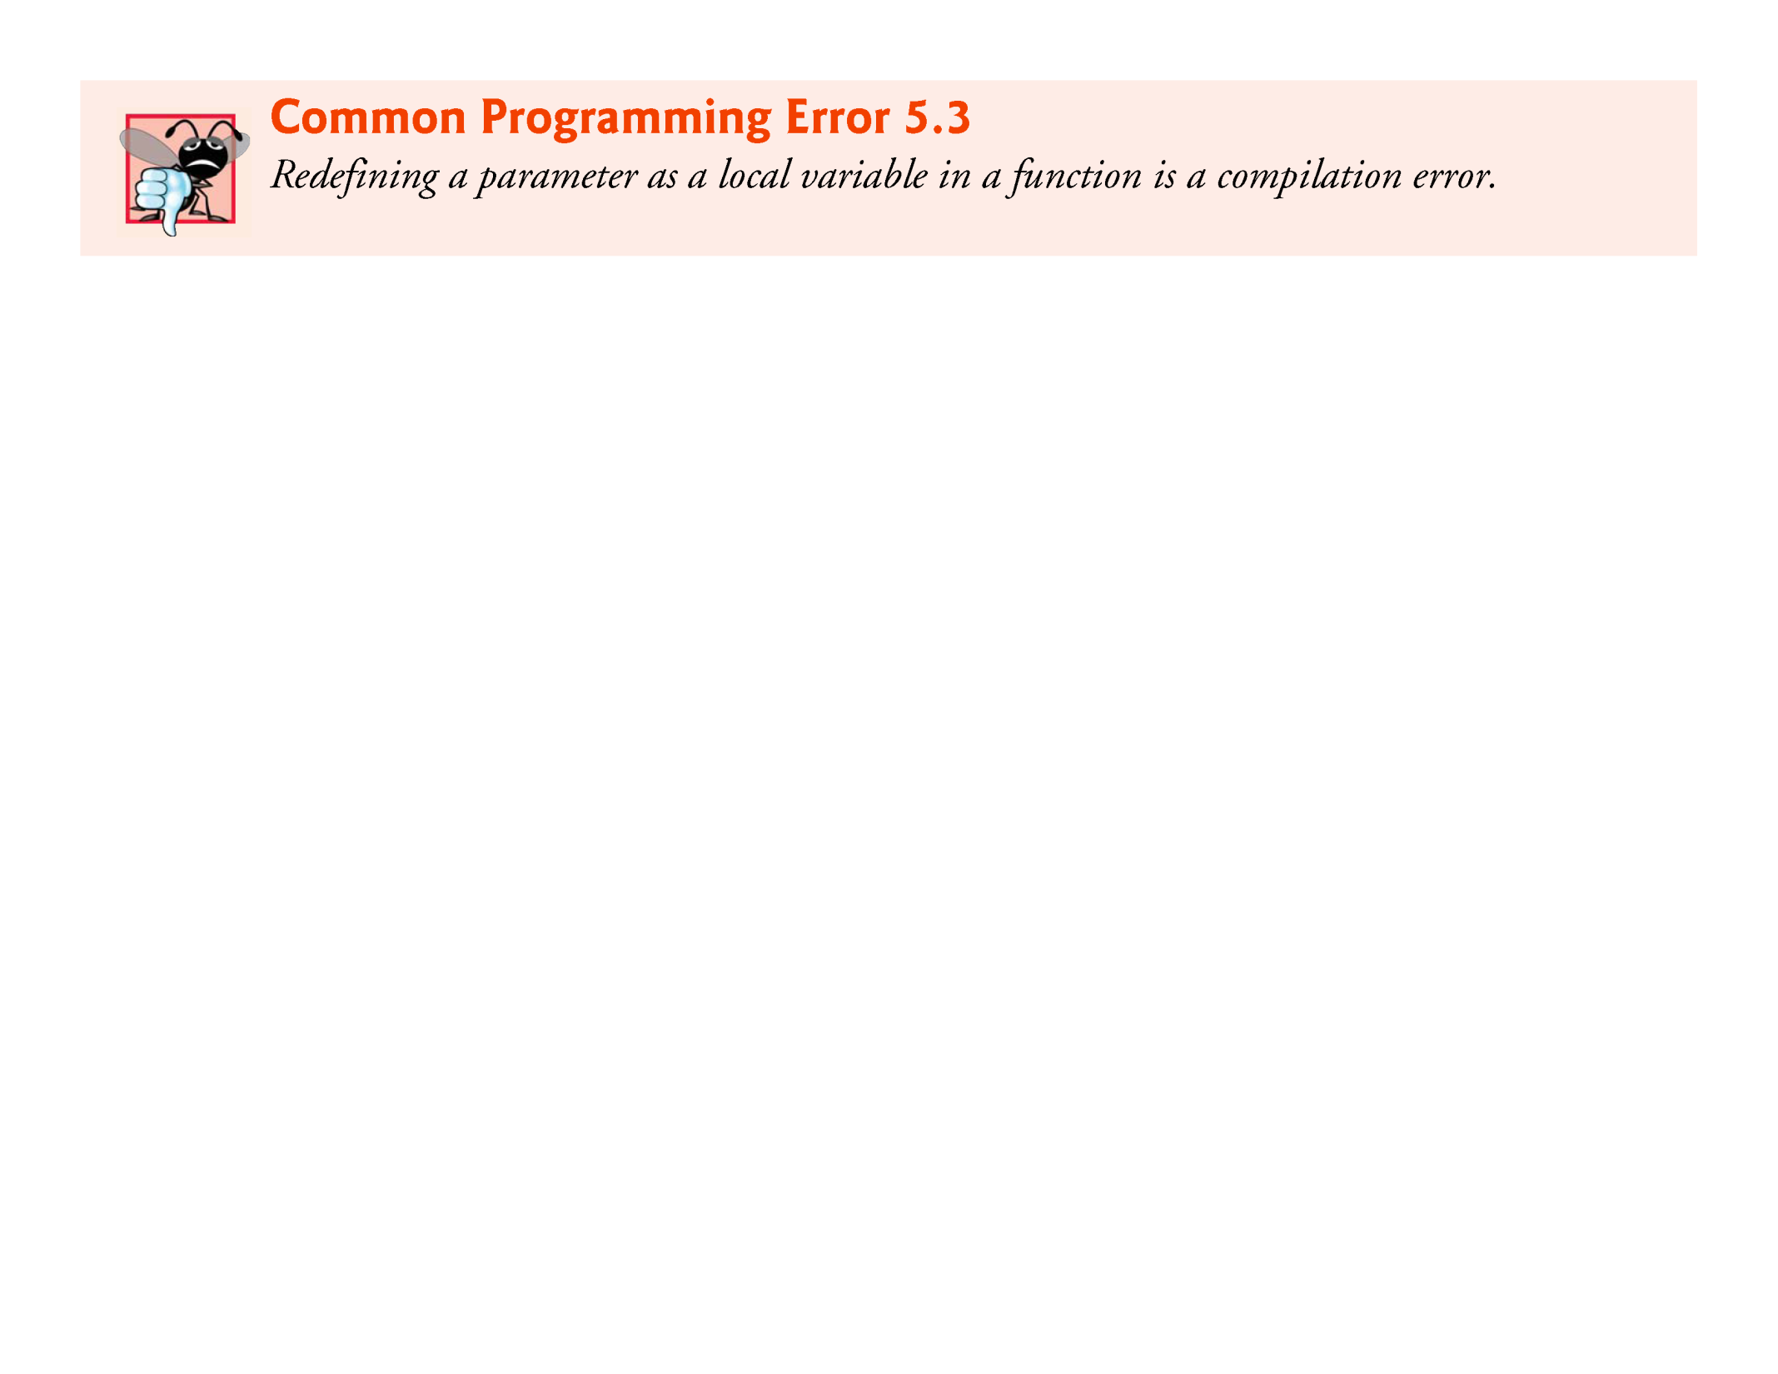

Slide 38
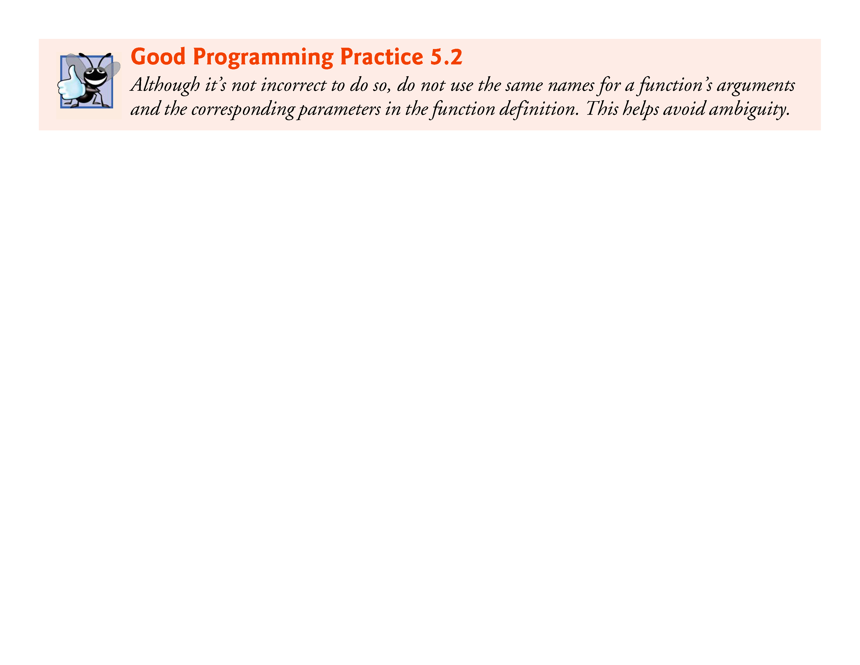

Slide 39
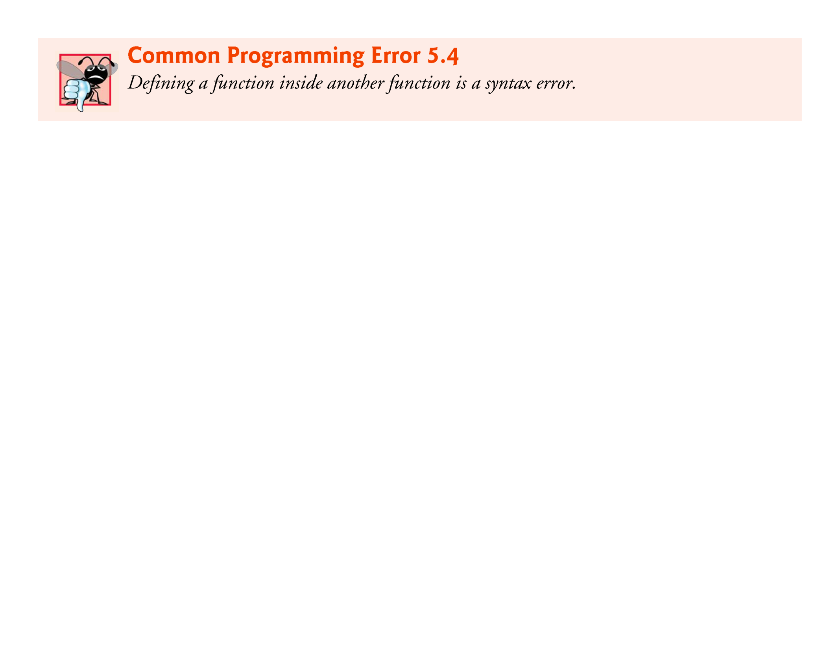

Slide 40
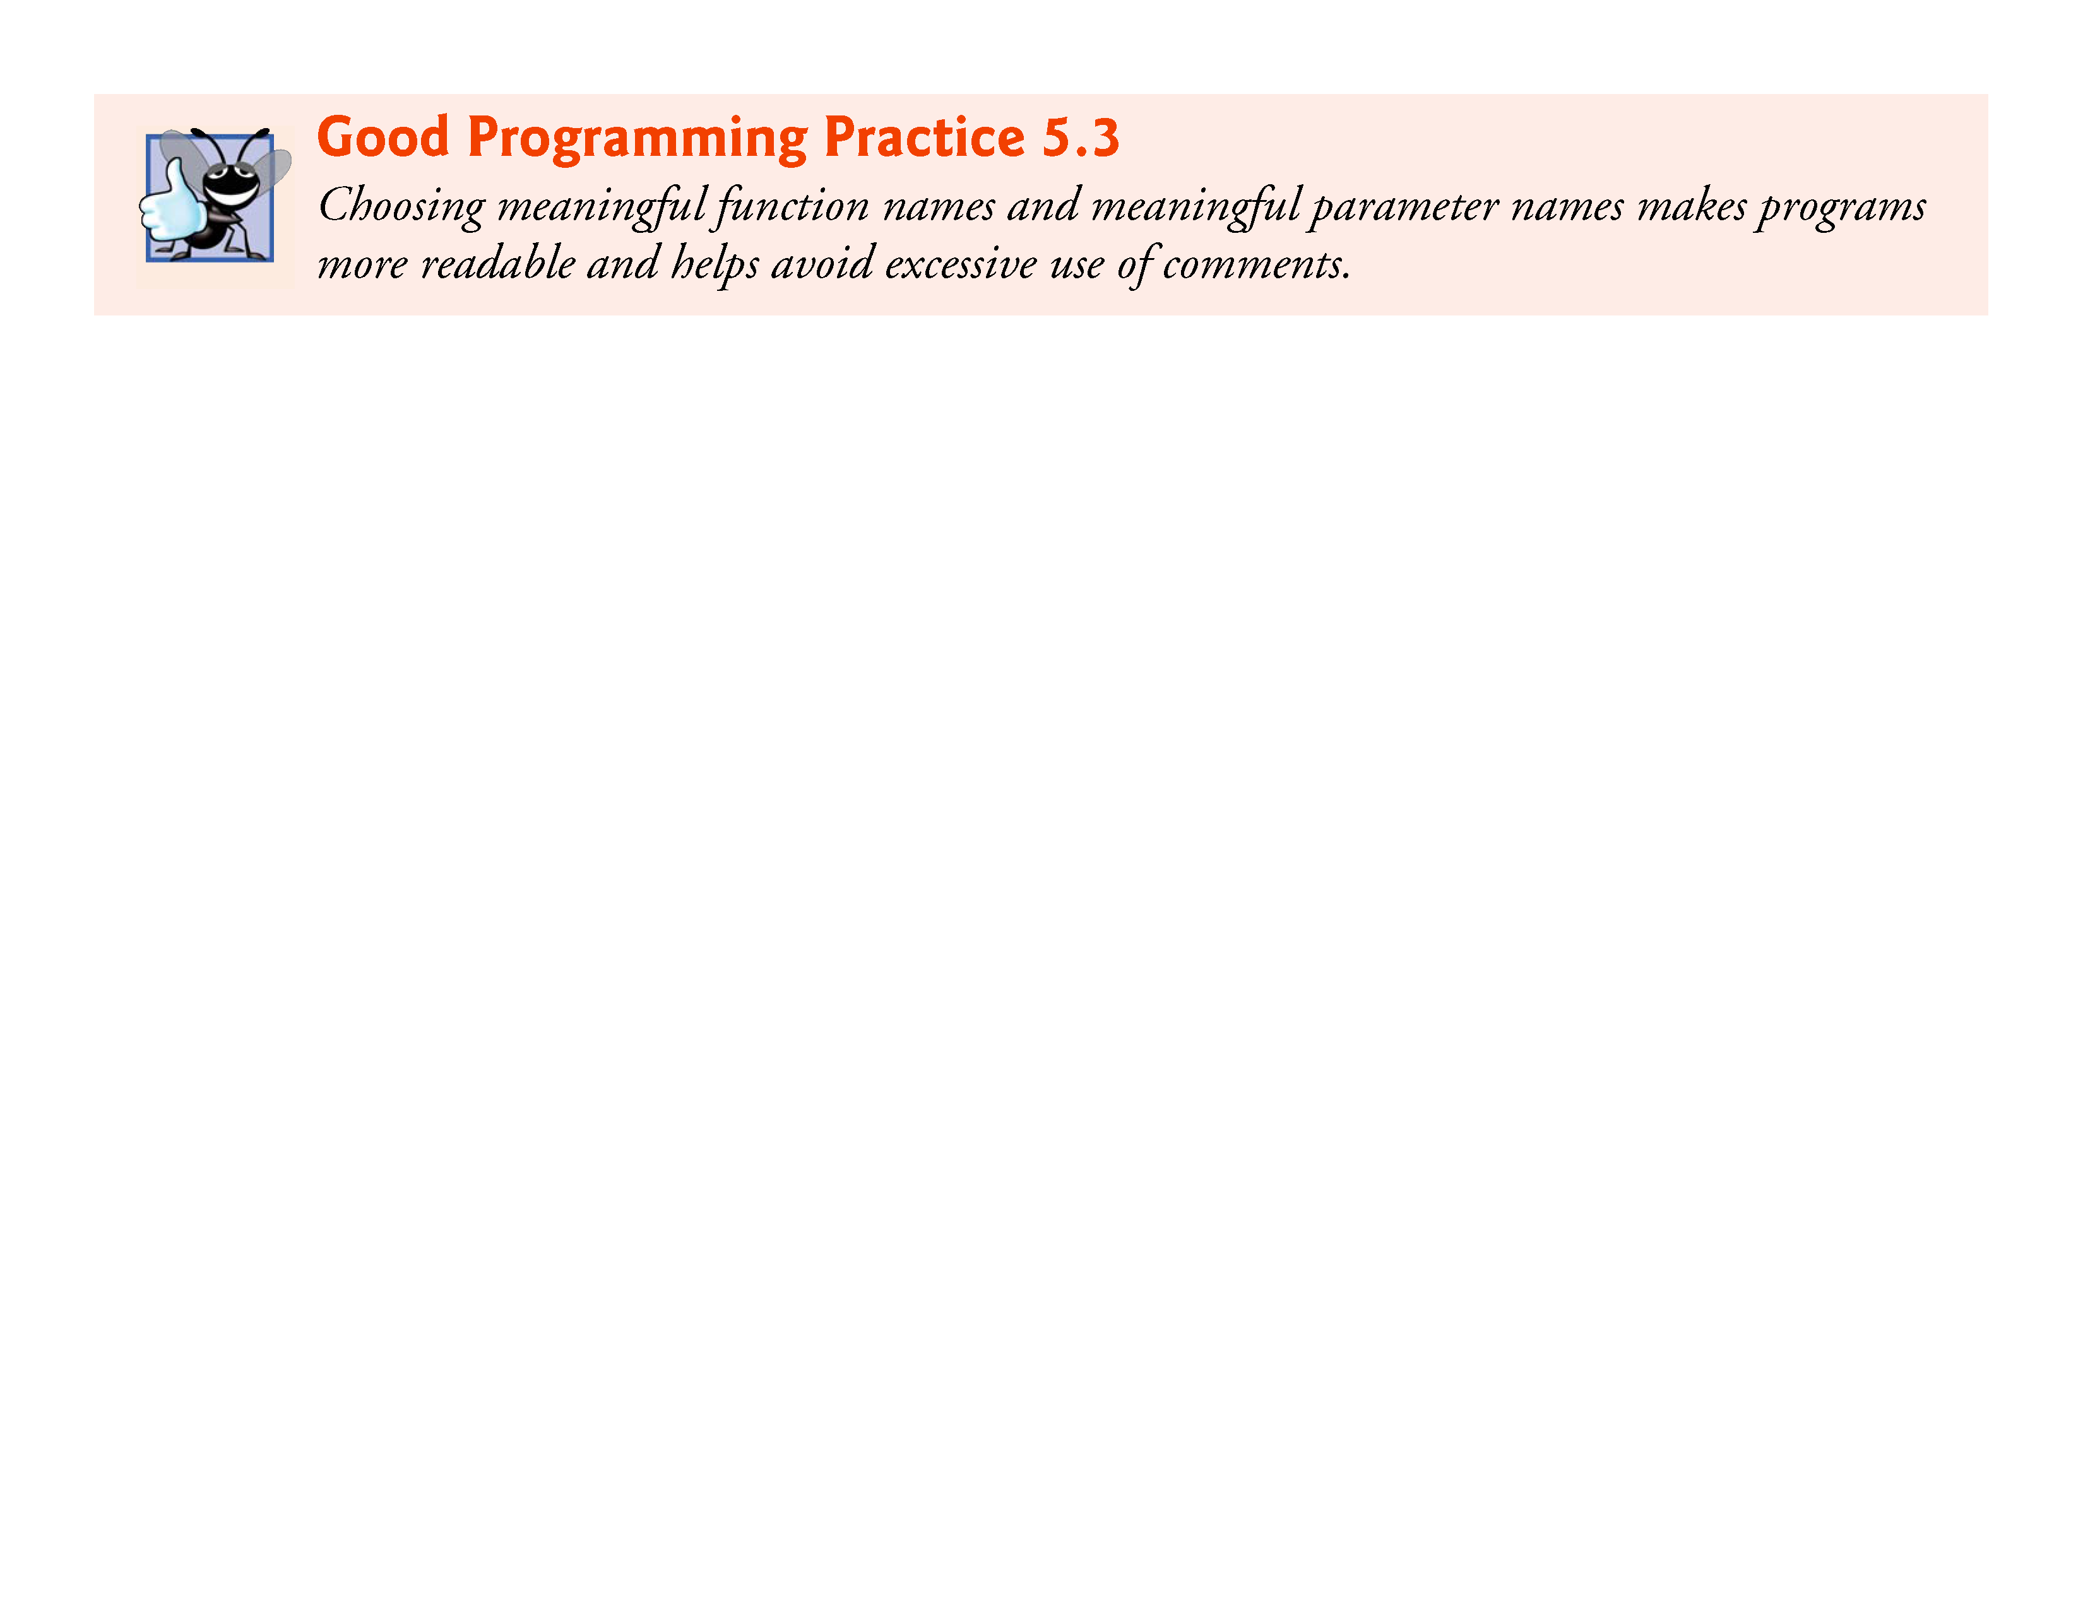

Slide 41
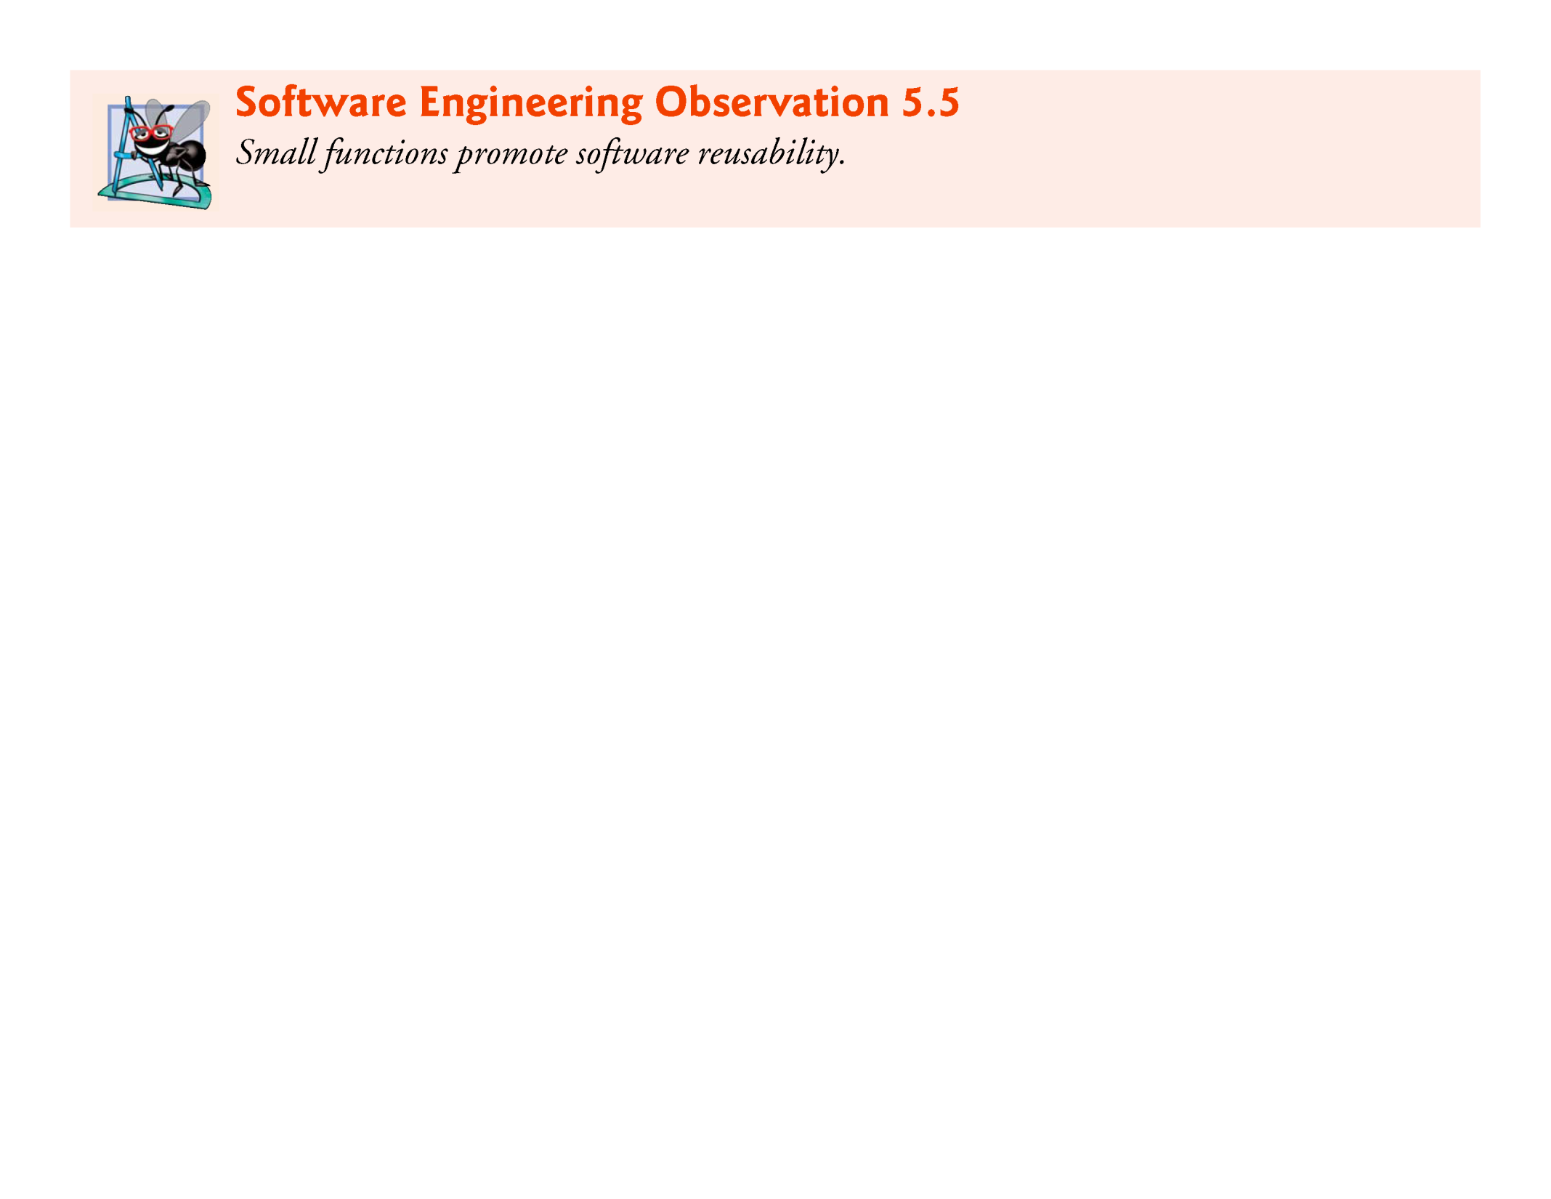

Slide 42
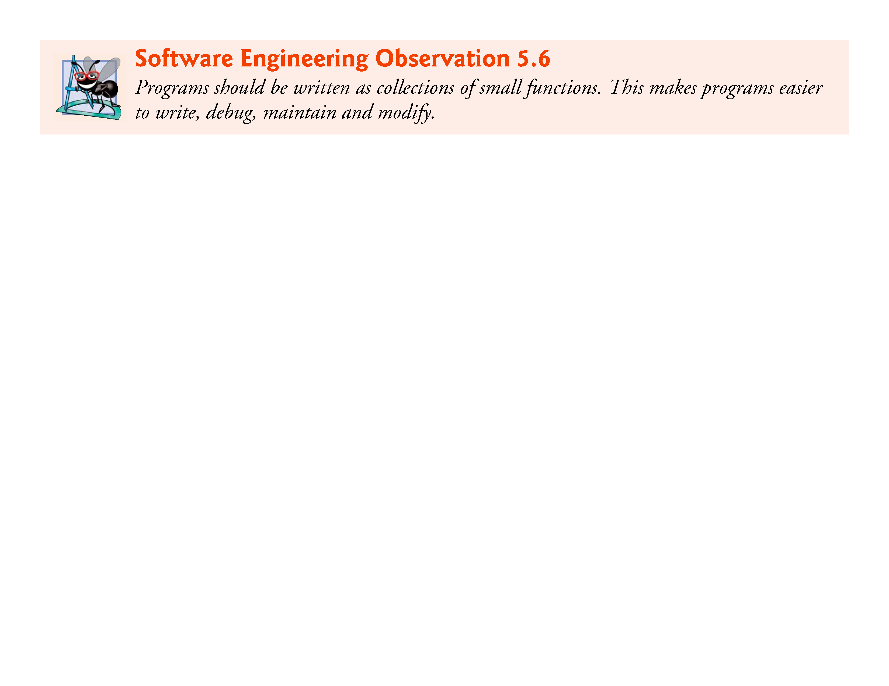

Slide 43
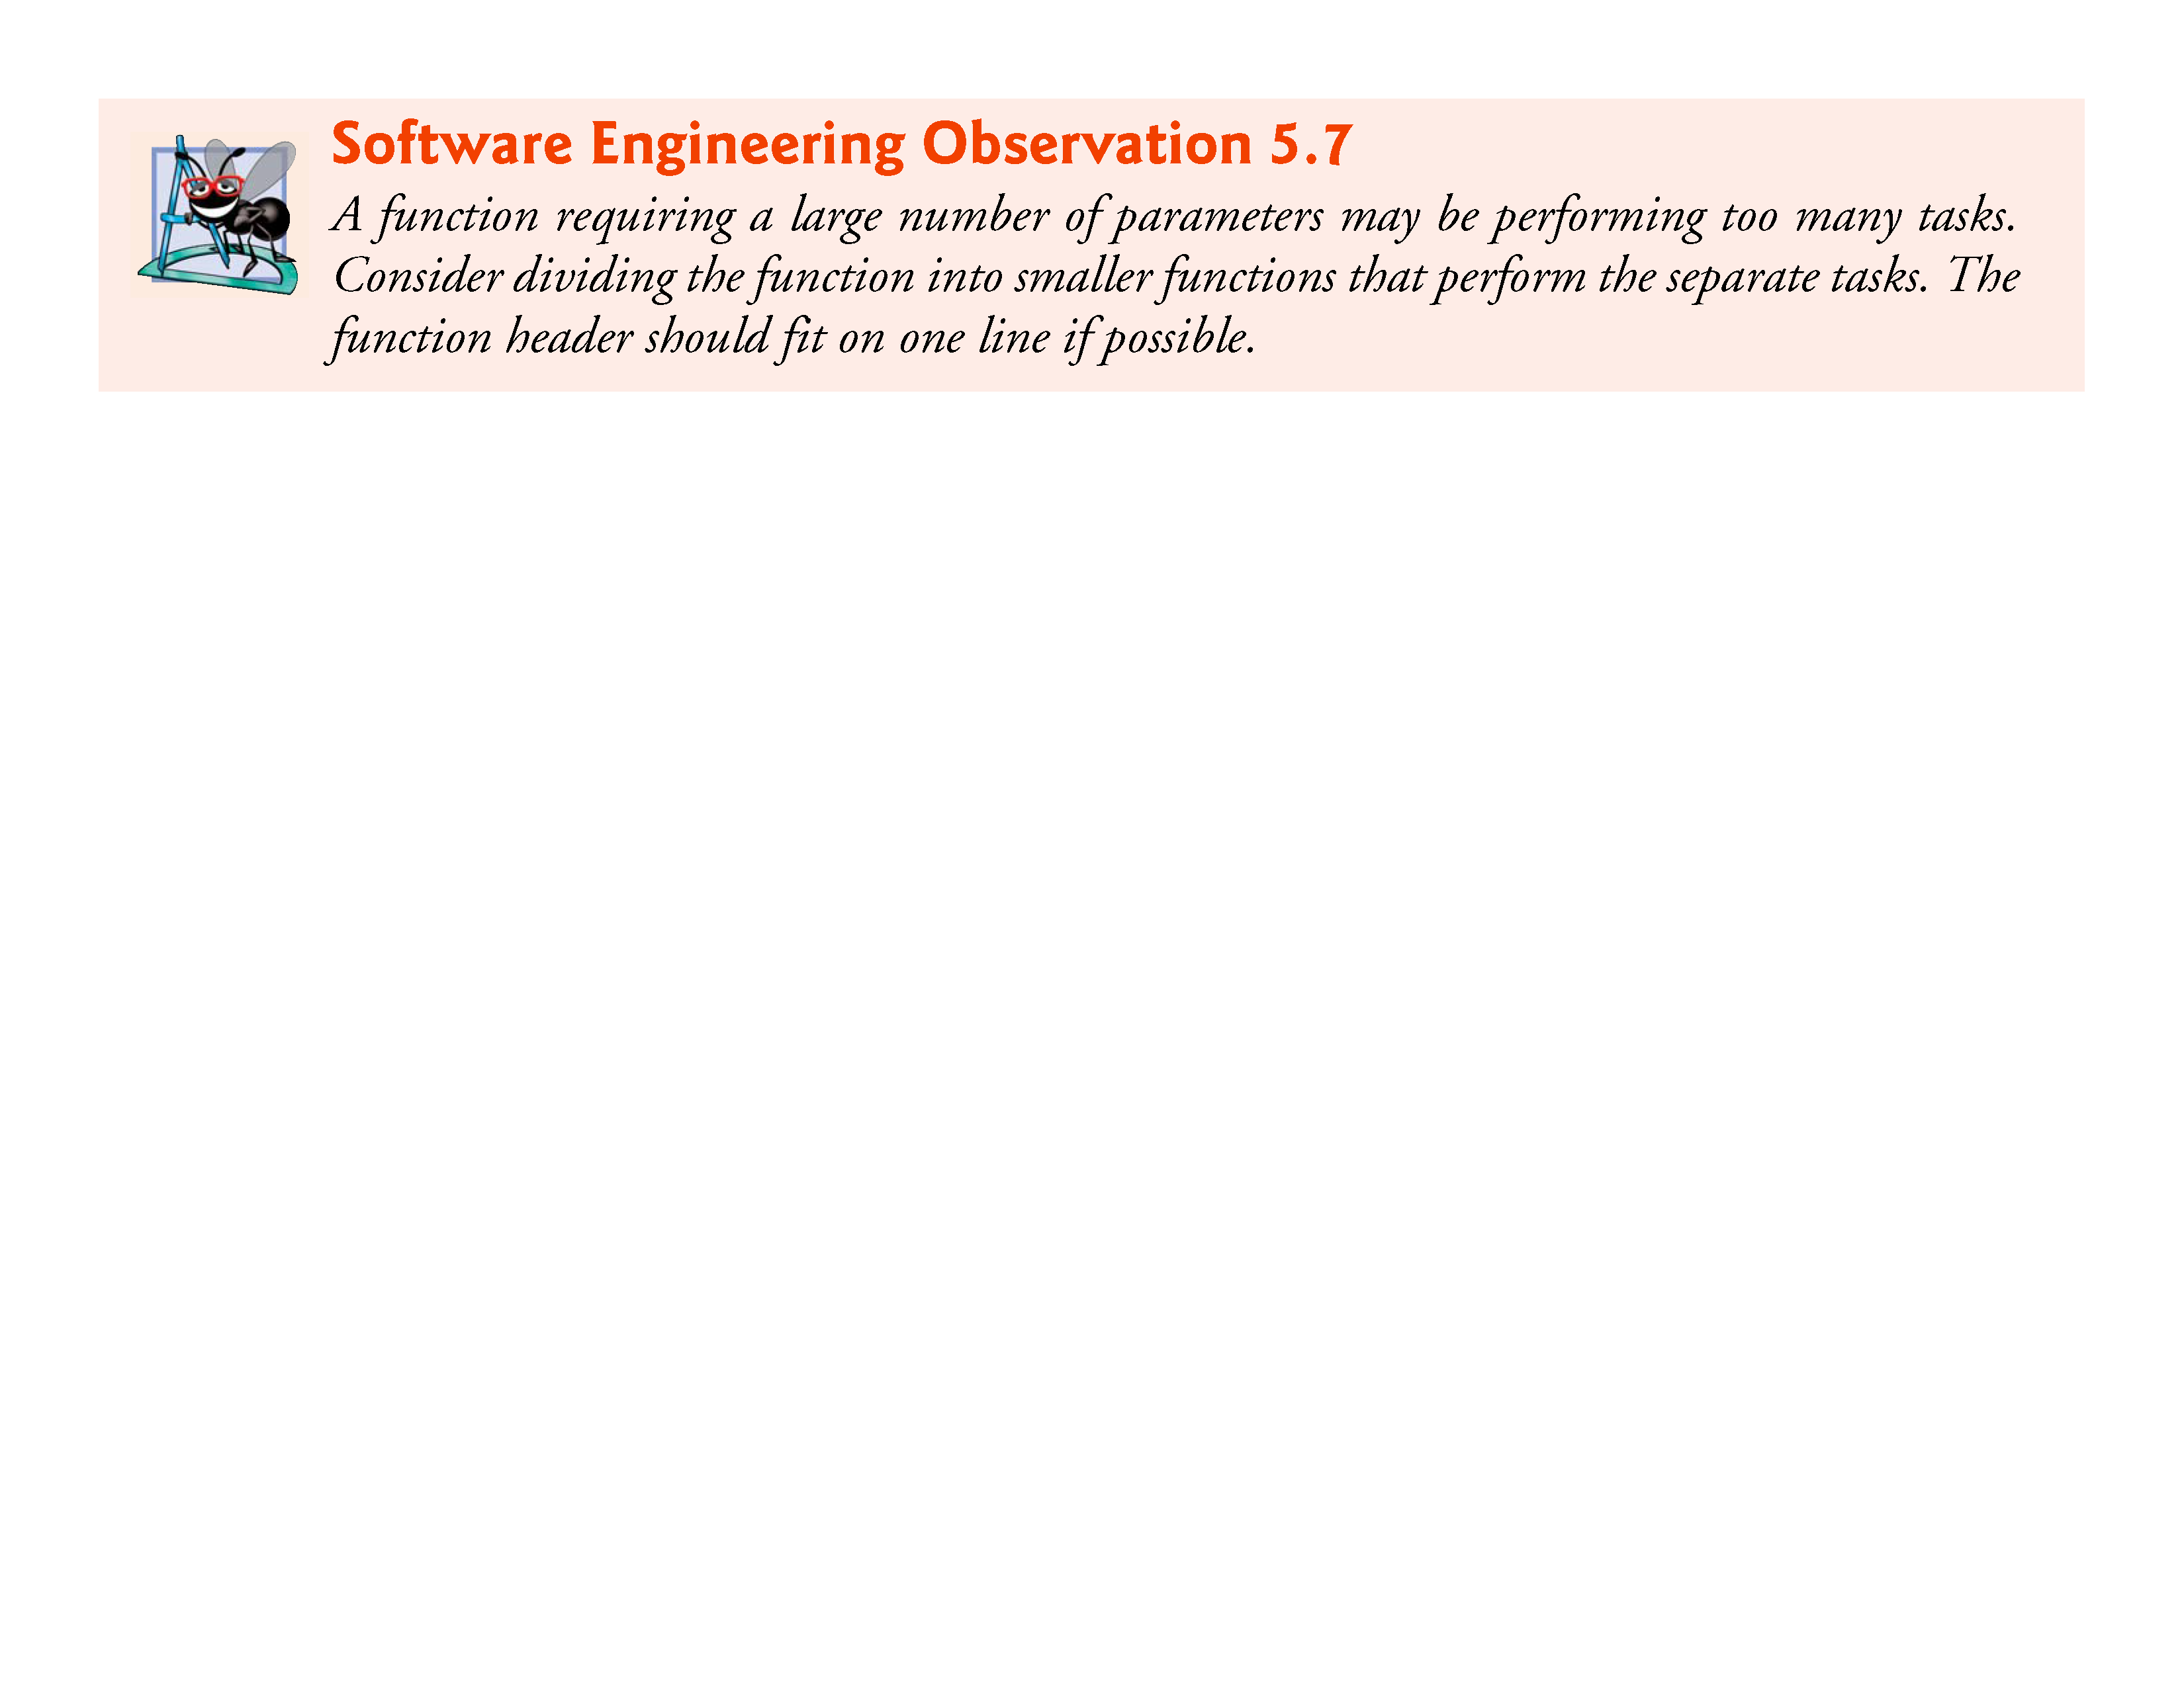

Slide 44
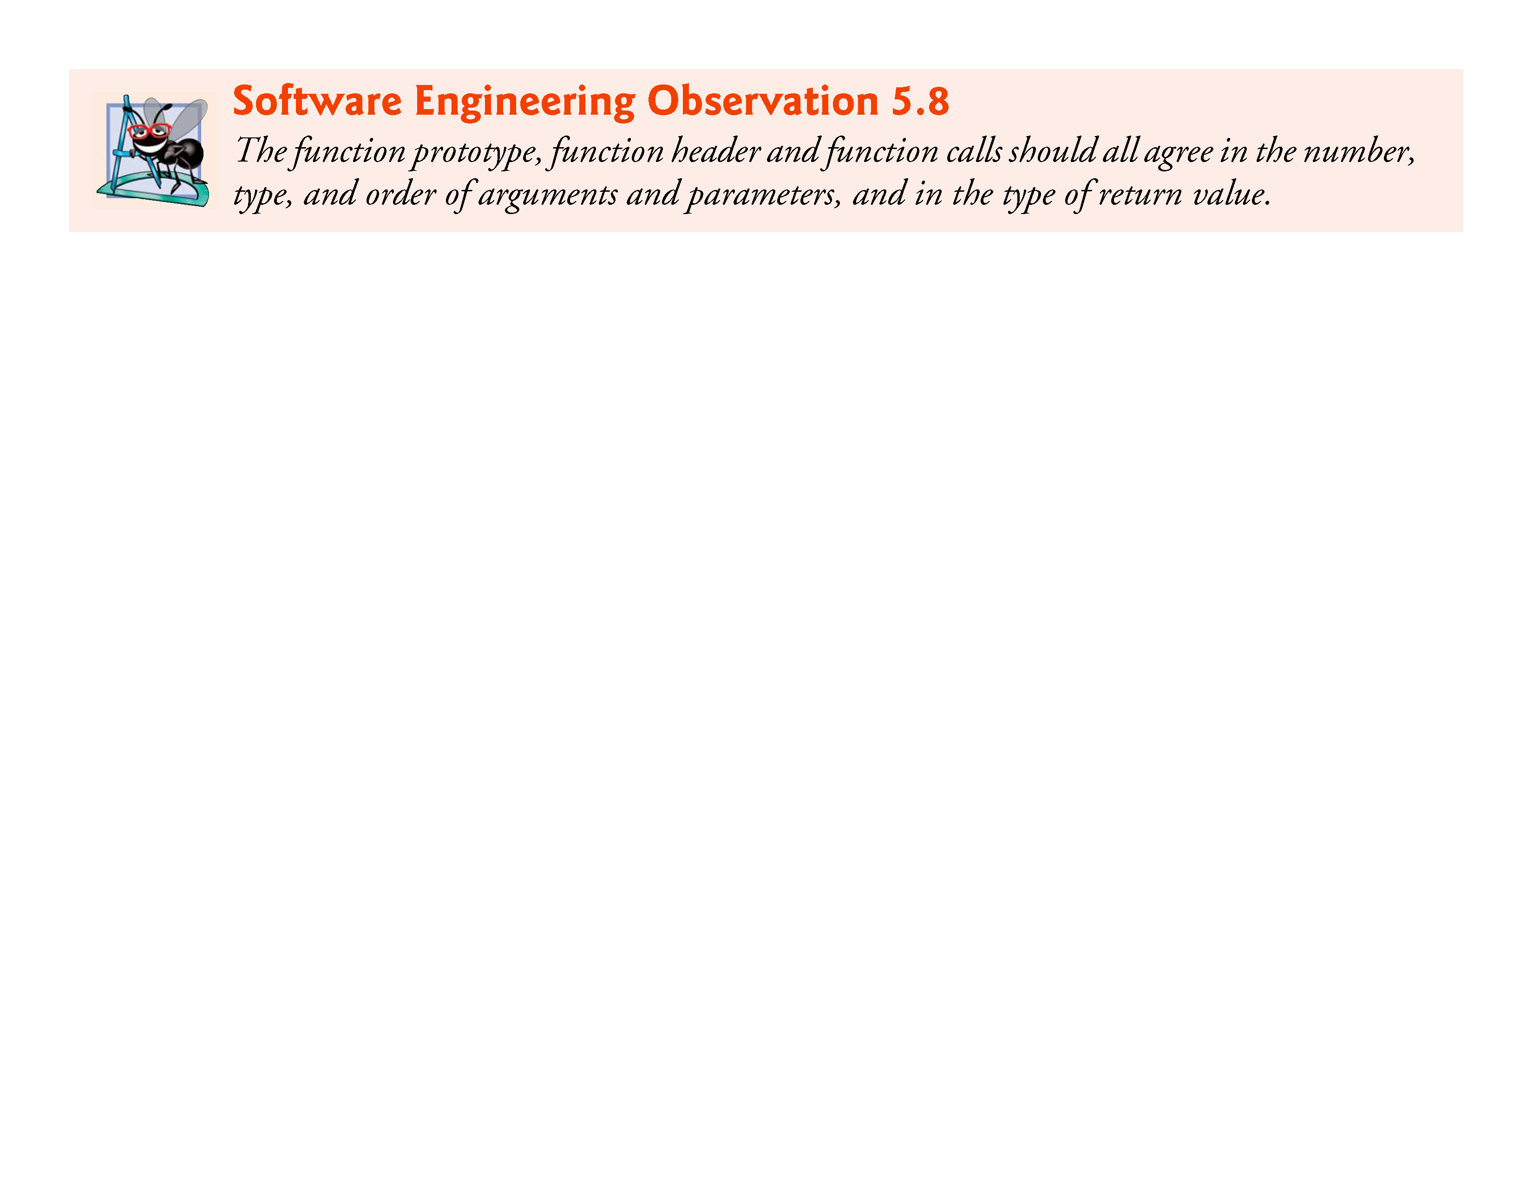

Slide 45
Q & A

